Slide 1
Using NVivo12 to Organize Information
David Haynes
Edinburgh Napier University

Slide 2
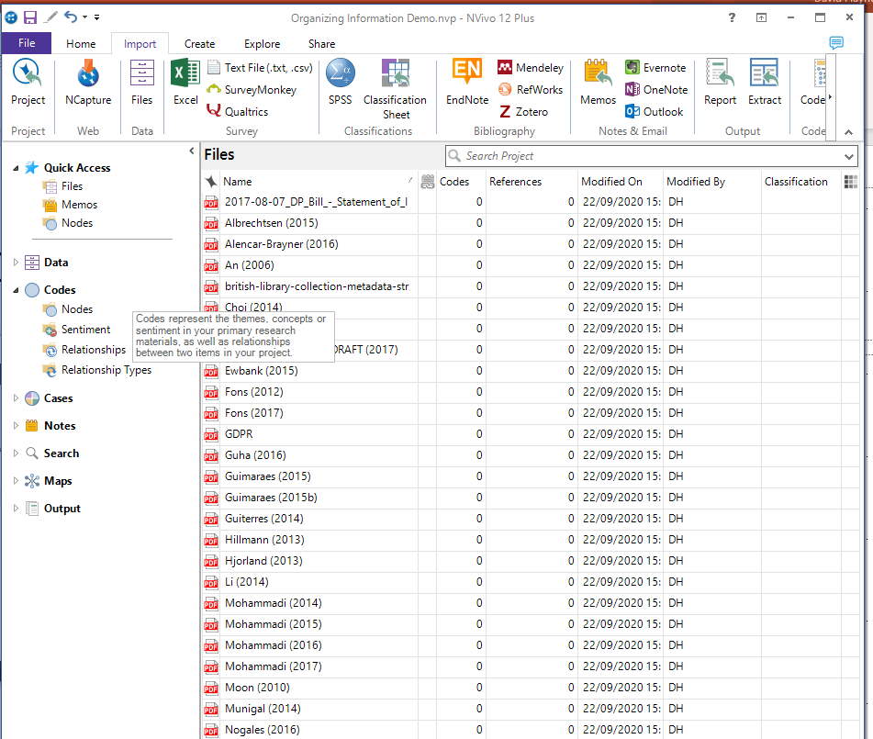
Corpus of Data
Selected full text articles from a literature search
Imported into NVivo12

Slide 3
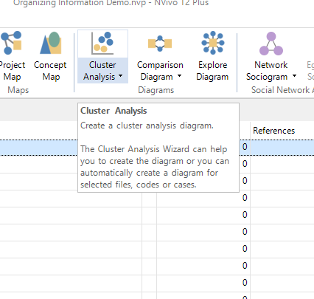
Explore data
Cluster analysis feature in NVivo will group items together by similarity
Automated process
Can group by pre-assigned codes, word similarity or other attributes

Slide 4
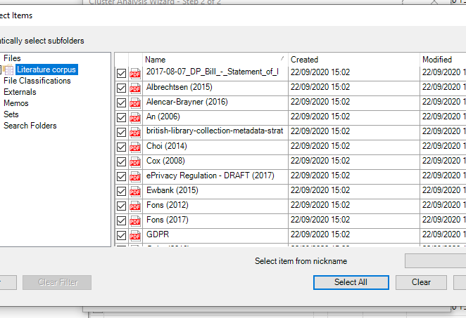
Select the items you want to compare

Slide 5
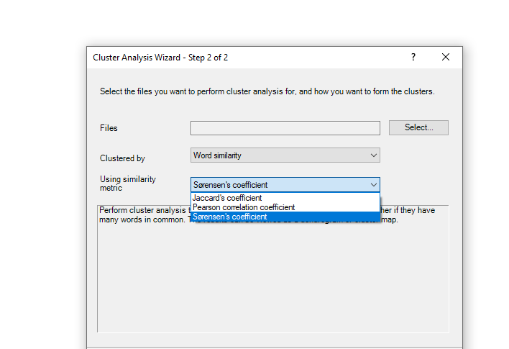
Setting the parameters

Slide 6
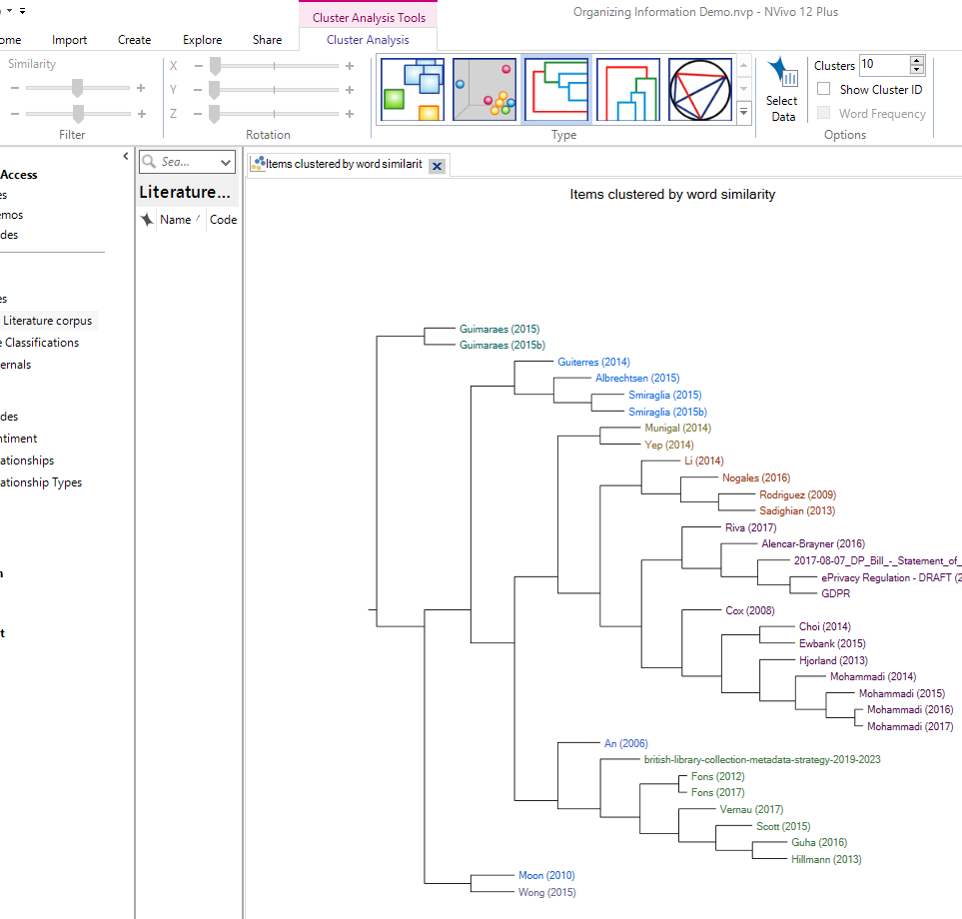
Clustered by Sørensen’s Coefficient

Slide 7
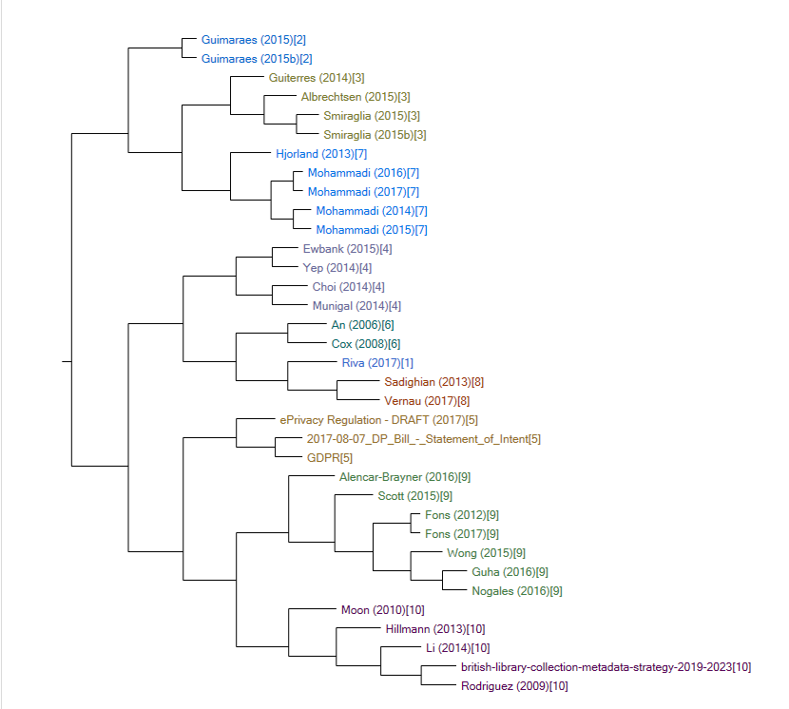
Clustered by Pearson Correlation Coefficient

Slide 8
Conclusions
Useful automated tool for identifying similar items
Still need to examine items in a cluster to see what it is about
Need to create category labels and descriptions
Does not automatically create a coherent taxonomy or typology, but is a useful first step – especially for a large corpus of data
Experiment with different settings to see what works best
It helps if you understand the algorithm used for clustering

