Slide 1
MS Teams – the case for Information Architecture and Governance
Alex Church
25th May 2021

Slide 2
Our Mission
Metataxis provides consultancy to organisations trying to manage one of their most important assets – their information.
We have a deep understanding of and extensive experience in architecting, organising and maximising the use of information.

Slide 3
About Us
SUCCESSFULLY OPERATING SINCE 2002
HIGHLY EXPERIENCED INFORMATION MANAGEMENT PROFESSIONALS
TEAM WITH BROAD RANGE OF SKILLS AND PRACTICAL KNOWLEDGE
250+ PUBLIC, PRIVATE & THIRD SECTOR CLIENTS
SMEs TO MULTI-NATIONAL CLIENTS

Slide 4
Our Expertise
INFORMATION ARCHITECTURE
MICROSOFT 365, TEAMS, SHAREPOINT
INFORMATION STRATEGY
GDPR
INFORMATION GOVERNANCE
INFORMATION MANAGEMENT
TRAINING
CHANGE MANAGEMENT

Slide 5
Just some of our clients
Central Government
Charities and non-profit
Local bodies
Private Sector
Higher Education
And much more…

Slide 6
What is Teams?
Communication
Chat, audio/video conferencing, telephony
Collaboration
Content sharing, storage, task management etc

Slide 7
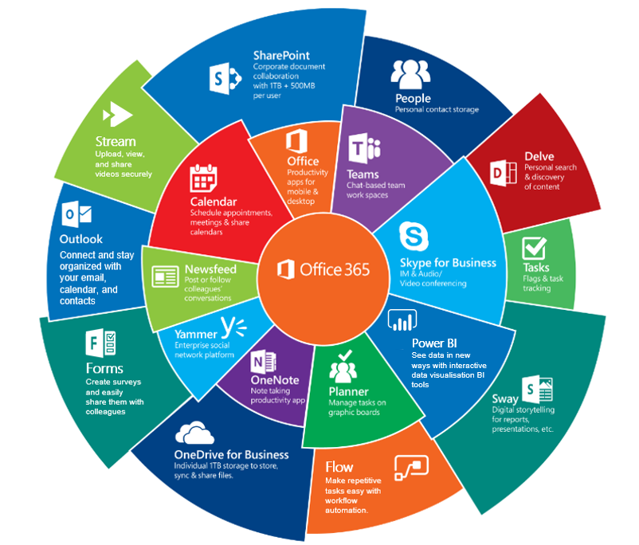
What is Teams?
Teams is just one part of Office 365…
A whole set of cloud business applications.

Slide 8
On the upside…
One of the best things about Teams is that it is easy to set up and use with a ‘low barrier to entry’ for colleagues to start using it straightaway to collaborate.

Slide 9
On the downside…
One of the worst things about Teams is that it is easy to set up and use with a ‘low barrier to entry’ for colleagues to start using it straightaway to collaborate.

Slide 10
Health warning!
Do not just turn Teams on, give everyone the application and then let them get on with it.
Doing that and it will very quickly become chaotic and messy.
Put in place governance around who can do what, where content is stored, managed etc.
Put in place information architecture to structure, organise and describe.

Slide 11
Creating a Team
It is tempting to allow anyone to create a Team as you may not want to restrict or slow down collaboration.
Please don’t.
Turn off self creation and put in place some approval and provisioning process.
This could be either manual, you could build your own or there are plenty of 3rd party apps.

Slide 12
Simplified Teams architecture
1:1, 1:X Chat
Files in 1:1, 1:X Chat
Files
Team chat
Stores
Stores
Stores
Creates a M365 Group
Personal mailbox
SharePoint
Group mailbox
One Drive

Slide 13
Teams and SharePoint
Every Team has a SharePoint site behind it.
A document library is created by default and a folder is also created for each Channel.
This is where your Team files are stored
Document Library
General
Channels
Channel A
Folders
Channel B

Slide 14
Private Channels
Private Channels are accessible only to a sub-set of Team members.
If you create a Private Channel in your Team it creates a separate SharePoint site, document library and folder.
Chat in the Private Channel are stored in the users’ personal mailboxes.
General
Channels
Channel A
Private Channel
Chat
Personal mailbox

Slide 15
Teams Information Architecture
Teams imposes a Teams/Channel = Library/Folder information architecture.
It gives you a ‘General’ channel/folder which cannot be removed.
This represents a change from ‘the folder is dead, long live metadata!’
However you can still add content types, custom columns etc to Teams folders through SharePoint.
Consider creating templates as part of provisioning process.

Slide 16
Naming a Team
Note that there is nothing to stop two Teams having the same name.
This may lead to confusion and impact findability.
Having a Teams naming convention is an important element of your information architecture and should be considered as part of your provisioning process.
Can be enforced through a ‘Group Naming Policy’ in Azure AD although prefixes/suffixes used are derived from the profile of the user who creates the group which may not be appropriate.

Slide 17
Public or Private?
Are your Teams going to be Public or Private by default?
Public teams are visible to everyone, and can be joined without approval of the team owner.
Private teams can only be joined if the team owner adds you. You can set private teams up so that people can find and request to be added as a member or you can turn this off so people can only find a team if it is shared with them.

Slide 18
SharePoint permissions
Anyone can find a Public Team.
Anyone can join a Public Team.
Anyone can search content of a Public Team.
Which is all good for transparency but all users on your tenant become Site Members of the Teams SharePoint site.
Anyone can edit or delete files in SharePoint without actually joining the Team!
Site Owners
Full control
Site Members
Edit
Site Visitors
View

Slide 19
Public or Private?
Site Owners
Team Members
Site Members
Public Team
Files
All staff
Site Owners
Site Members
Team Members
Private Team
Files

Slide 20
Public or Private?
Site Owners
Site Members
Team Members
Public Team
Files
Site Visitors
All staff
Consider changing permissions of a Public Team SharePoint site at the time of provisioning to make ‘All Staff’ read only Site Visitors.

Slide 21
Teams Lifecycle
Having the ability to manage the lifecycle of your Teams is a strong part of your governance armoury.
There are a number of tools that you should really consider.
Expiration policies
Retention policies
Retention label policies
Archiving

Slide 22
Simplified Retention/Disposal
Expiration Policy
Retention Policy
Retention Policy
Retention Labels
Deletes
Applied to
Applied to
Applied to
Deletes
Deletes
Retains/Deletes
Retains/Deletes
Retains/Deletes
Messages
Files
Files
Deletes
Deletes
Files
Messages
Except, at the moment, for messages in Private Channels

Slide 23
Lifecycle policies
Expiration Policy
Requires Azure AD Premium
Applied to the Group
Deletes all Teams content and apps
Can be a set time period or be based on last activity
Team owners get warnings that Team will expire and have the option to ‘Renew’
Retention Policy
Applied to messages/chat
Applied to files
Set at Team / Site level by admins
Applied to all content in the Team/Site.
Can retain content for certain period.
Can delete content after a certain period
Retention Labels
Applied to files
Admins can set defaults/auto application (requires E5 Licence)
Can use IA/metadata to apply at scale
Can be applied/changed by users
Applied at a document level
Can retain content for certain period.
Can delete content after a certain period

Slide 24
Precedence
If an Expiration Policy has been set but the content is marked to be retained for a longer period via Retention Policies or Retention Labels then the content won’t be deleted.
The Team will been deleted but the content remains in the appropriate ‘retention container’.
Note that these are not visible to users but are discoverable via retention and eDiscovery functions.
Retention Labels
Takes Precedence
Retention Policy
Takes Precedence
Expiration Policy

Slide 25
Archiving
Makes a Team read-only for members.
Can be done by a Team Admin or the Team Owner.
‘Hides’ the Team but it is still searchable.
Team owners can still edit/delete documents
More of a usability feature than a compliance one.
Can be restored anytime by Admin or Owner

Slide 26
Other things to consider
External access – are you going to allow external ‘guest’ access? If you do so then beware that this a ‘universal’ setting by default so if you allow self creation of Team you can’t prevent them adding external guests.
3rd party apps – who can add 3rd party apps? May open other information silos
How does it fit with existing architecture? - do you use SharePoint sites to store content? What is the relationship between SharePoint and Teams? Do you want to ‘teamify’ existing SharePoint sites?
Search - At present the search bar in Teams just searches files, chat etc stored in Teams. The search bar in SharePoint will search across all files including those stored in SharePoint via Teams. It does not search Teams messages/chat.

Slide 27
Final thoughts
Teams is a great tool and is the direction of travel for Microsoft.
You will get value from it but you will also create problems for yourself if you don’t put in place governance and information architecture.
Consider, plan and proceed with caution.

