Slide 1
Beyond the Hero’s Journey:
The Architecture, Structure and Strategy of Narrative
Paul Rissen
Senior Product Manager, Springer Nature
Tuesday, 20th April 2021

Slide 2
Introduction
Notes:
First of all, thanks for coming.

Slide 3
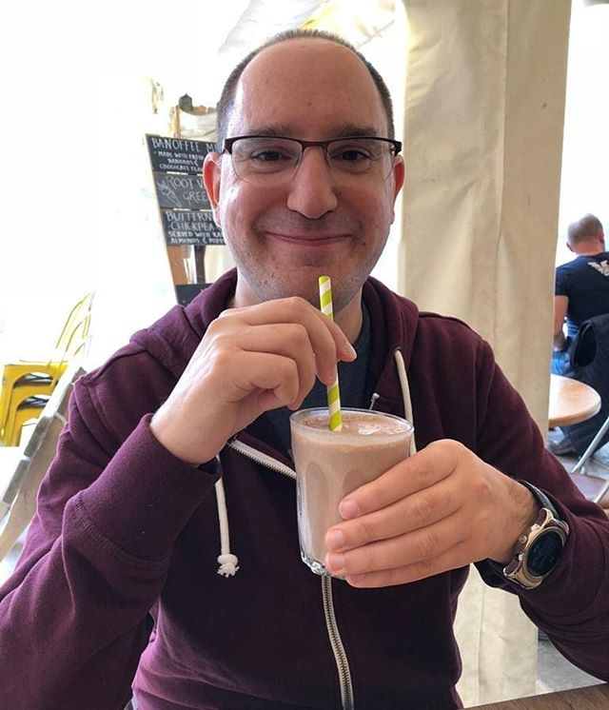
Hello. I’m Paul.
Senior Product Manager, Springer Nature
~10 years @ the BBC
Co-wrote A Manifesto for Structured Journalism whilst working with BBC News Labs
Product Manager for Springer Nature’s Recommended service; journal sites; now Nature Briefing
Product Managed several digital storytelling prototypes whilst at the BBC
Doctor Who, Chelsea FC, storytelling structure nerd

Slide 4
A Three-Layer Architecture of Narrative
Story Knowledge - how much the audience knows about the past/current state of the story.
Story Telling - the process of revealing selected elements of the Story World.
Story World - the ‘objects’ within the world of a story, and the connections between them.
Visualisation by Sarah Challis (@pausesnotpixels)
Notes:
This is similar to the basic three-level architecture of web applications.
Story world = tags, concepts, the domain model stuff
Telling & Knowledge are the things which are most important to this session.
There is at least one more layer but we’ll come to that later.

Slide 5
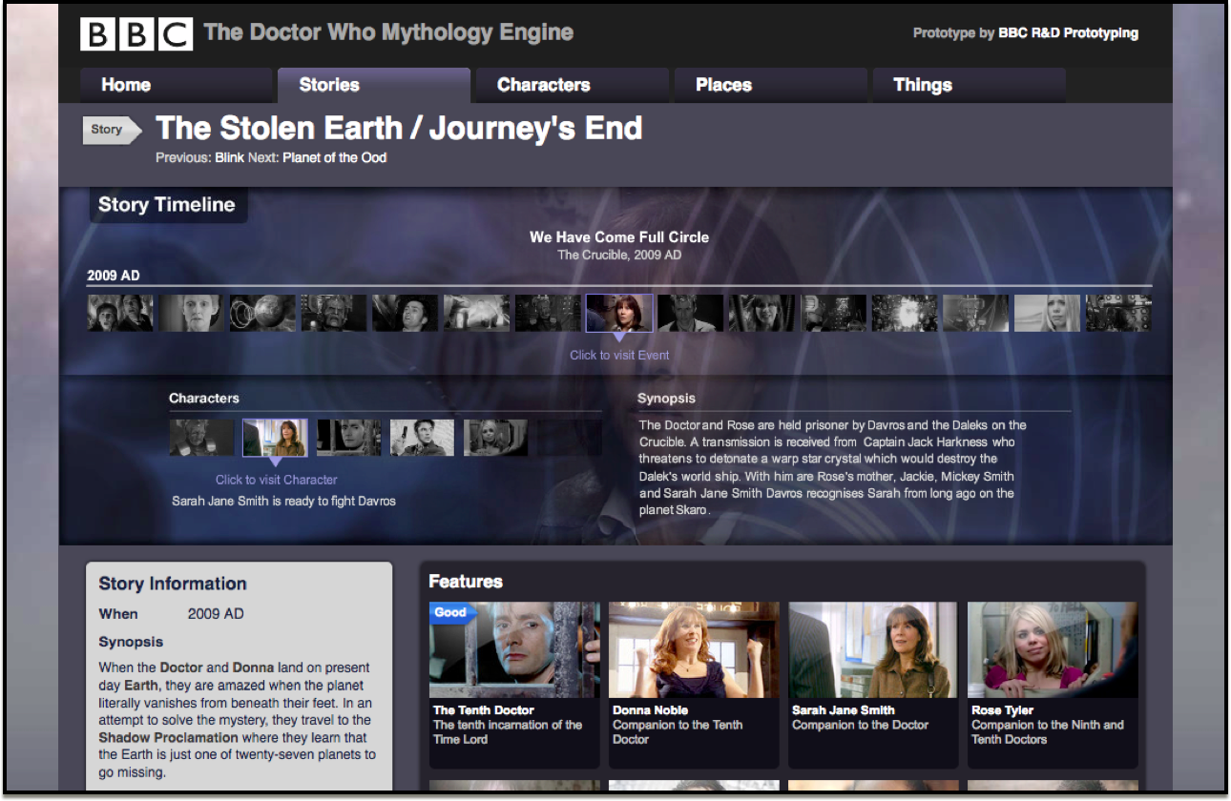
Notes:
Talk about Myth Engine prototype, 2009-10, which broke stories down into events and characters, also showing participation in the event.

Slide 6
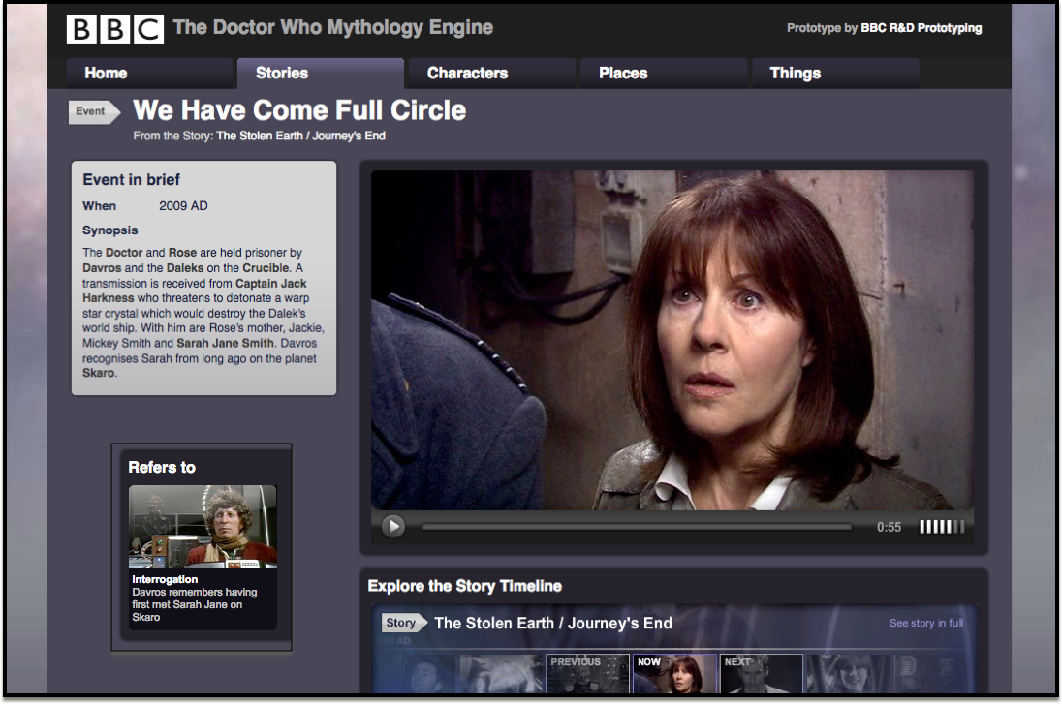
Notes:
Show how an event can refer to a past event...

Slide 7
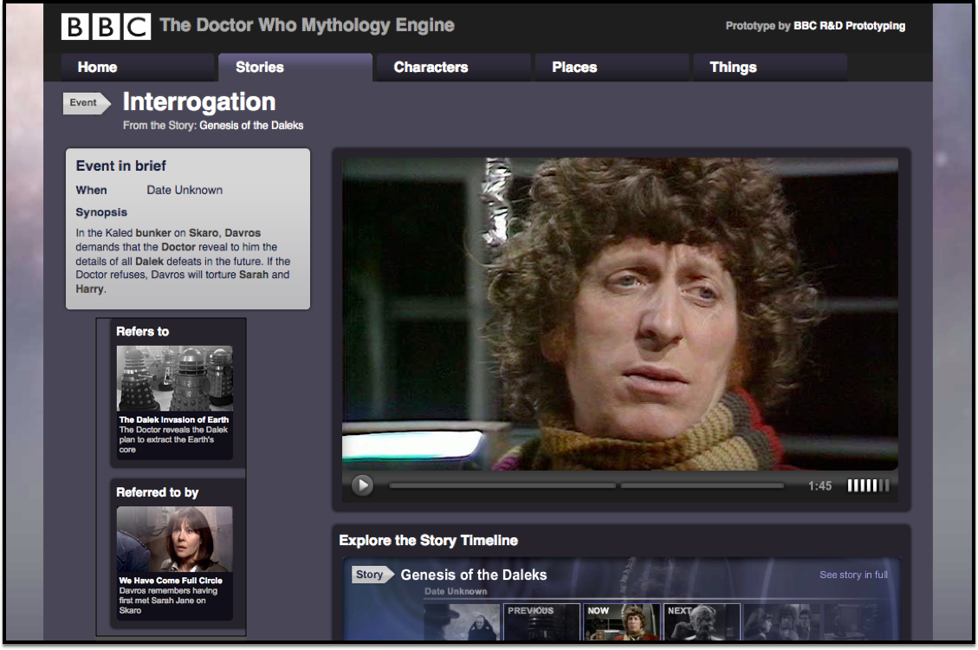
Notes:
Creating a web of narrative.

Slide 8
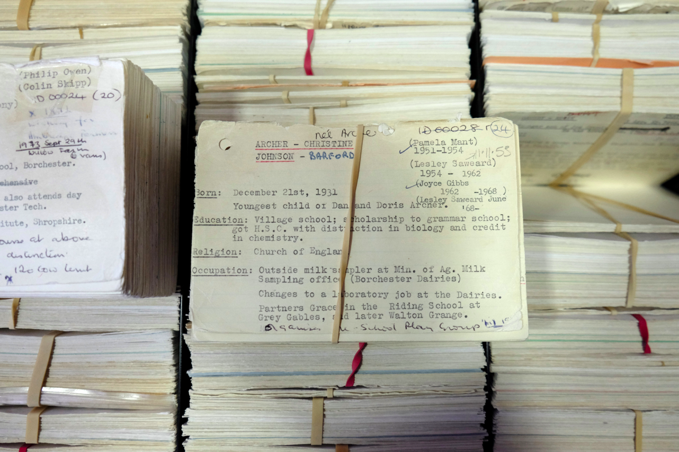
Notes:
Not just Doctor Who - see also the Archers.

Slide 9
Notes:
Not just fiction - see also BBC Monitoring. Same basic model of storytelling (or rather, the storyworld).

Slide 10
Narrative Events
Kernels - Key events that shape the whole plot - the turning points.
Satellites - Inessential to the plot, they provide texture, tone and character richness, and create a deeper connection with audiences
Notes:
One of the key skills of any storyteller is knowing when, and in what order, to deploy each event - to elicit certain feelings or responses in the audience
also to keep them engaged, keep them guessing, give them satisfaction etc.
In the context of journalism, you may not know what the kernels are...

Slide 11
Story Telling
Notes:
What I don’t mean…
‘drama = conflict’
‘the hero’s journey’
‘save the cat’
‘three act structure’
‘video on the web’
‘branching narratives’
‘scrollytelling’

Slide 12
Storytelling is the revelation of connected information over time.
Notes:
The order in which you reveal information fundamentally changes the perception of the story - add other notes from medium post.
In terms of journalism, revelation could be discovery, too.

Slide 13
Fabula vs Syuzhet
Terms coined by Vladimir Propp:
FABULA - “The raw material of a story.” (Chronological order)
SYUZHET - “The way the story is organised.” (Narrative order)
Diagrams by Michael Smethurst (@fantasticlife)
https://smethur.st/posts/66087518
Notes:
Basic differences between reality and storytelling - but this can be expanded upon in the next slide...

Slide 14
Three kinds of ‘time’
Story Time (chronological order)
Discourse Time (narrative order)
Narration Time (‘experienced’ time)
Notes:
The most fundamental technique we can play around with is time - the ordering of the revelation.
There are three types of time to be aware of - they exist in parallel, but can be used for effect, too.
Story time = chronological time within the story world = history, what you look back on at the end. Whether it ‘makes sense’ or not can be a strength and a weakness..
Discourse time = “temporal structure and duration of the story as told”, reordering of events to tell the best story, flashbacks, flash forwards etc. (utilised often in fiction but also journalism…we’ll come back to this)
Narration time = “temporal framework involved in telling and receiving the story” - screen time, reading time - has a great effect on the experience, but also isn’t fully under the author’s control. It can be harnessed, though, in the release of narrative - cliffhangers to maintain suspense, return visits, and so on.

Slide 15
Narration Time (and Format)
Notes:
Narration time can also have an impact on format - are these a single story told across many episodes (serial) or separate stories loosely (or not at all) connected (anthology/episodic)

Slide 16
Story Knowledge

Slide 18
“Storytelling is the dramatisation of the
process of knowledge assimilation.”
John Yorke, Former Controller of BBC Drama Production

Slide 19
Narrative Statements vs Narrative Enigmas
Narrative Statement:
A fact is established
There is little or no ambiguity
Sets the constraints of what’s possible
Narrative Enigma:
Events that are (initially) unexplained
Create uncertainty and mystery
Used deliberately to incite intrigue
Notes:
Events can be both Statements & Enigmas
An event might make statements, establishing facts/truths, but in turn, pose new questions both about what’s happened before, and what might happen in the future.
- they’re interesting because they engage the viewer.
- they invite the viewer to keep a tally of facts and questions
- and to constantly assess the importance of said facts/questions (will they be kernels or satellites?)
- all of which is to guess where the story will go next.
- if it goes in a different direction from that which is expected, is that satisfying, or inconsistent/annoying?

Slide 20
Narrative Statements
Lead to Anticipation Hypotheses, aka ‘what might happen next’
Used to set, and/or subvert expectations
Get audiences thinking about future possibilities and implications
Encourage sharing of ideas
Notes:
Cliffhangers!
“Serial narratives thrive by creating narrative statements that demand the next bit of information, inspiring our anticipatory hypothesising about what might happen next, to sustain us through the structured gaps between episodes."
Why is that interesting?
- self sustaining, addiction, plays into real life/twitter etc.
- also something to do with the skill and deliberate use of gaps in delivery of information.

Slide 21
Narrative Enigmas
Lead to Curiosity Hypotheses (i.e. ‘how did we get to this point?’)
They encourage forensic examination
All about trying to make sense of what has been revealed
Notes:
They invite speculation about who/what/when/where/why/how - questions about the past
they’re useful as beginnings, or as interruptions/changing up the status quo

Slide 22
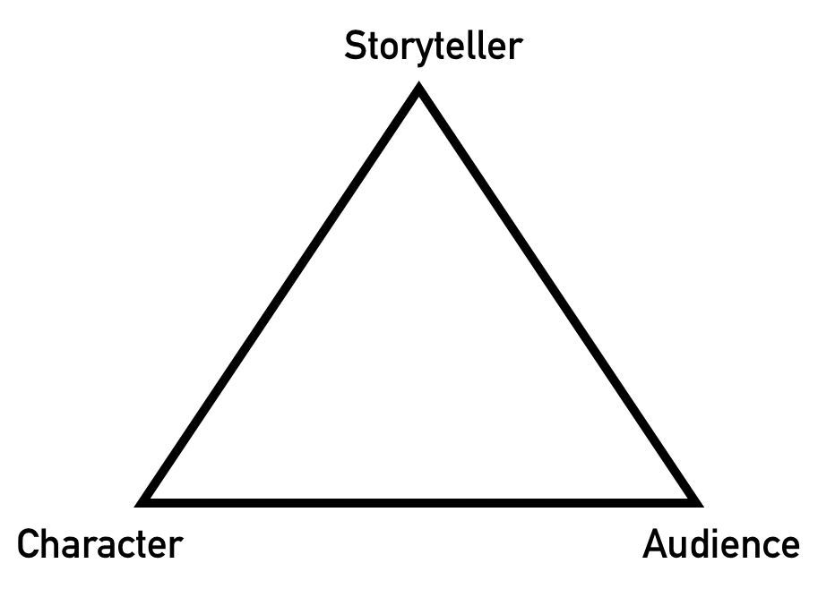
The Asymmetry of Knowledge
Storyteller to Audience
Character to Character
Character to Audience
Audience to Character
Audience to Audience
Audience to Storyteller
Notes:
Storyteller to Audience = standard revelation, surprise
Character to Character = staple of drama - not conflict, but disparity in knowledge.
Character to Audience = mystery - they know more than we do
Audience to Character = suspense - we know more than they do
Audience to Audience = spoilers, hypotheses, speculation
Audience to Storyteller = speculation, frustration, fan fiction!

Slide 23
Story Making

Slide 24
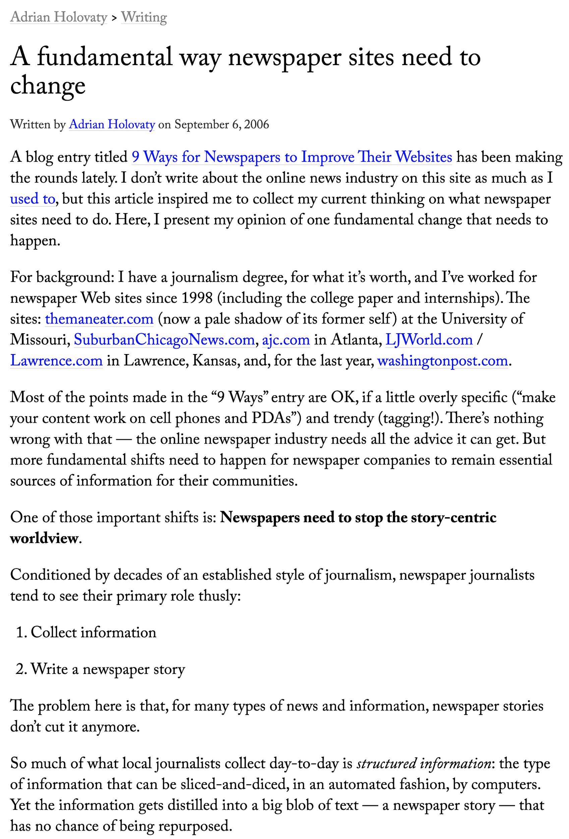
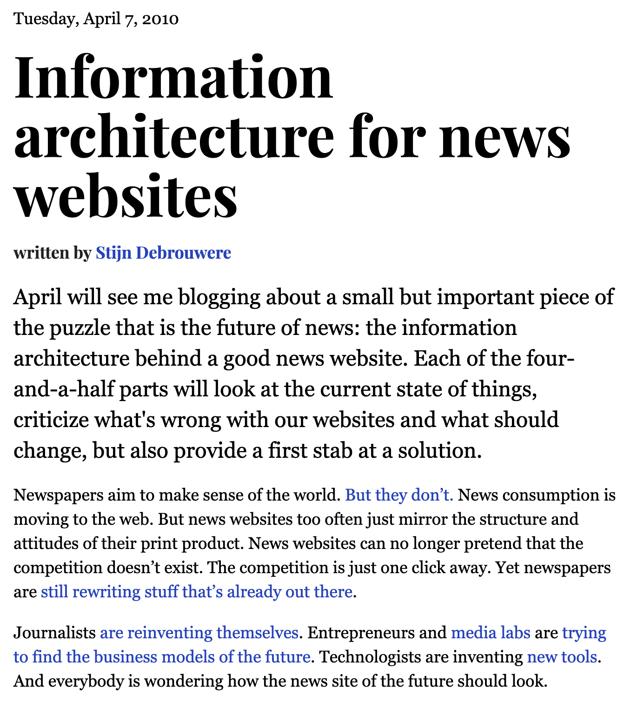
http://www.holovaty.com/writing/fundamental-change/
http://debrouwere.org/2010/04/06/information-architecture-for-news-websites/
Notes:
Also Reginald Chua: https://structureofnews.wordpress.com/2010/08/12/structured-journalism/

Slide 25
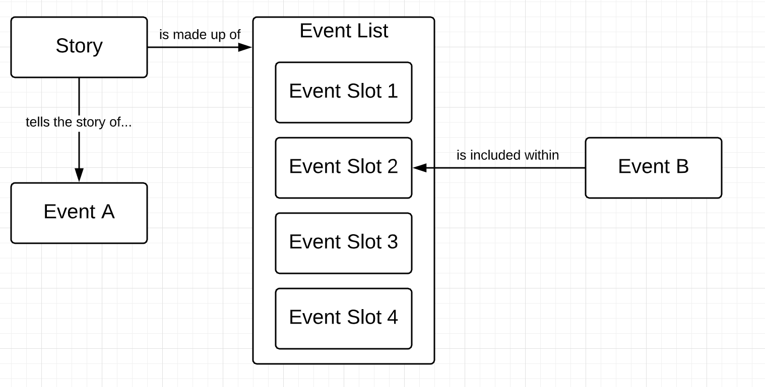
A model for Story Making

Slide 26
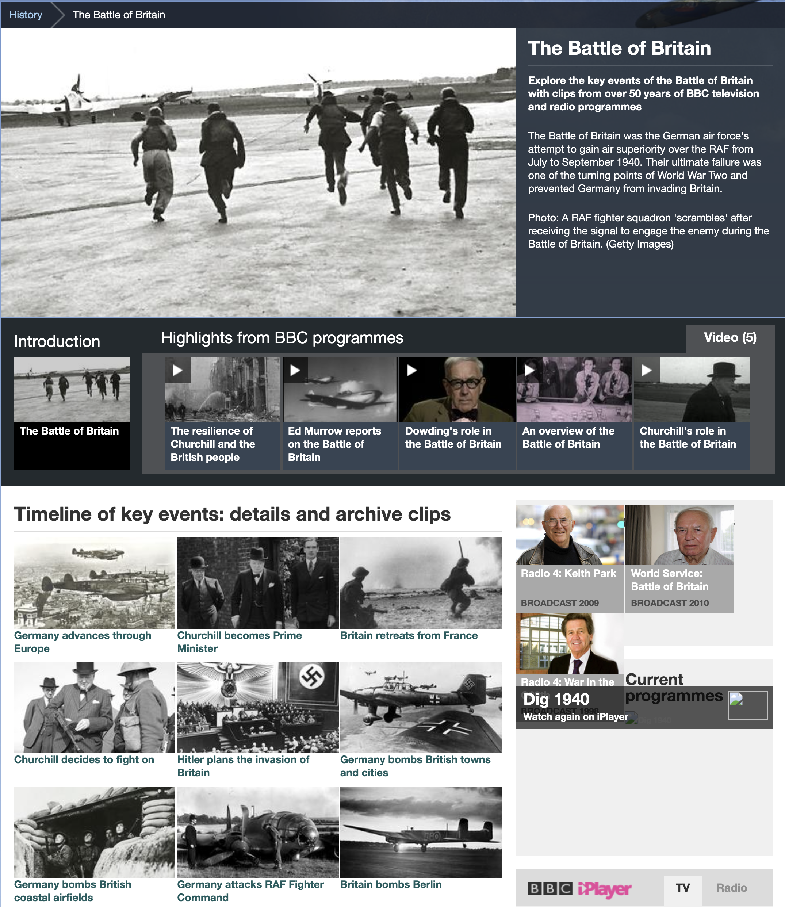
The Battle of Britain

Slide 27
The Battle of Britain

Slide 28
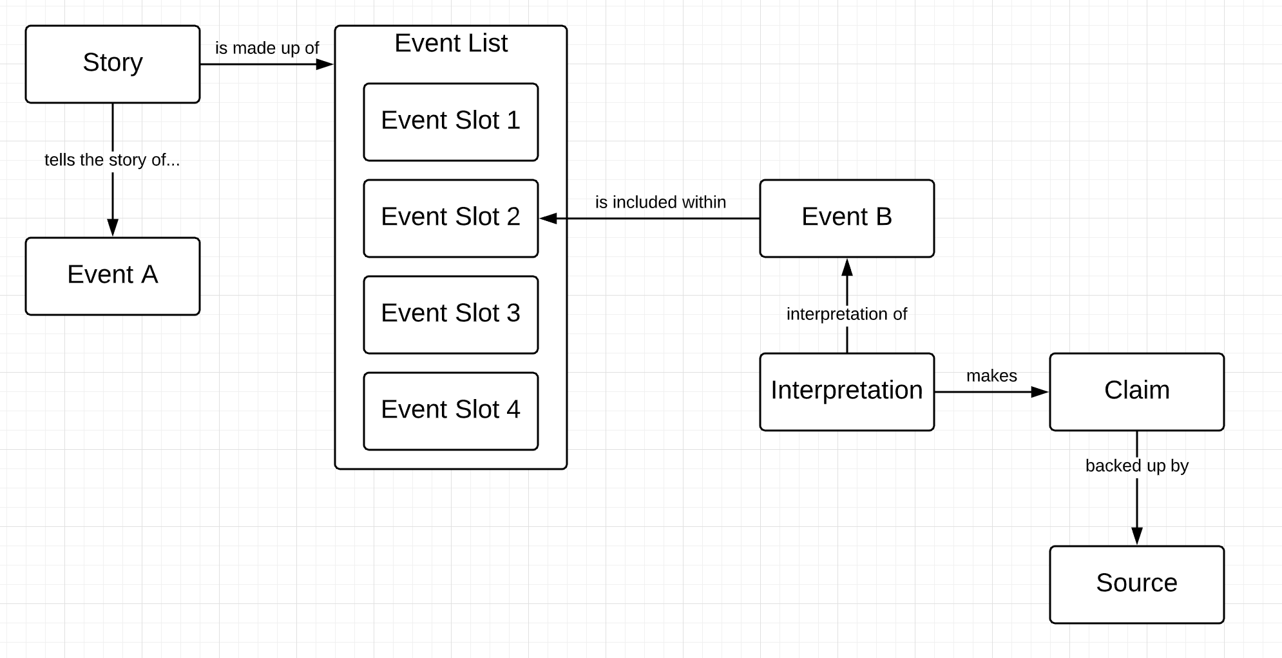
Incorporating Interpretations and Evidence
Notes:
The power of multiple interpretations...

Slide 29
Notes:
Multiple interpretations, event can be in multiple stories.

Slide 31
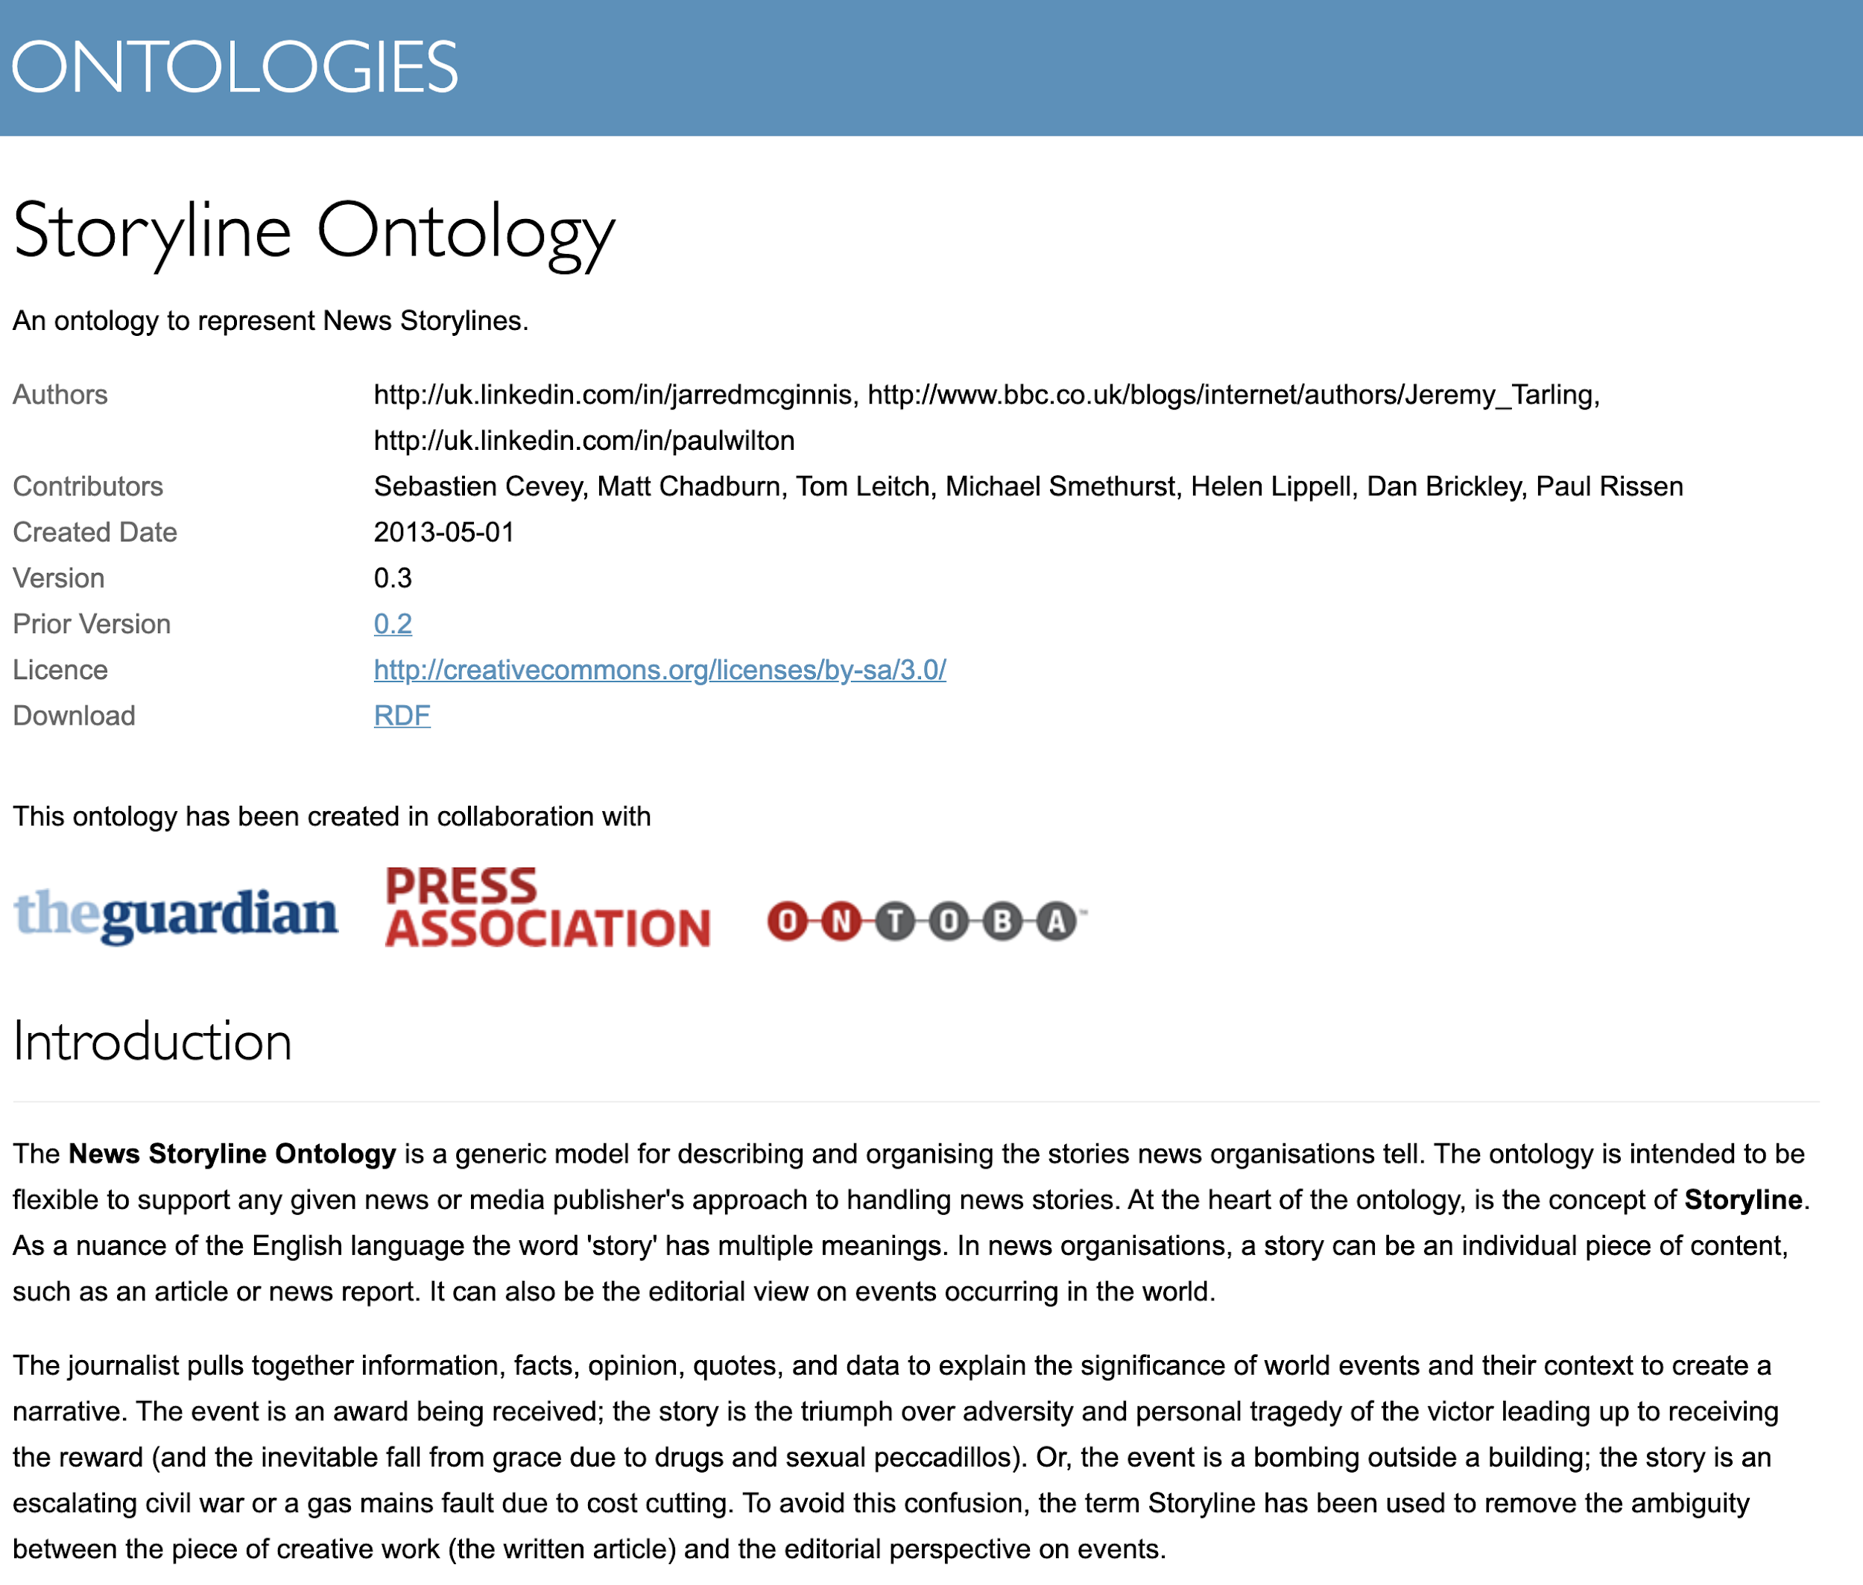
The Storyline
Ontology (2013)

Slide 32
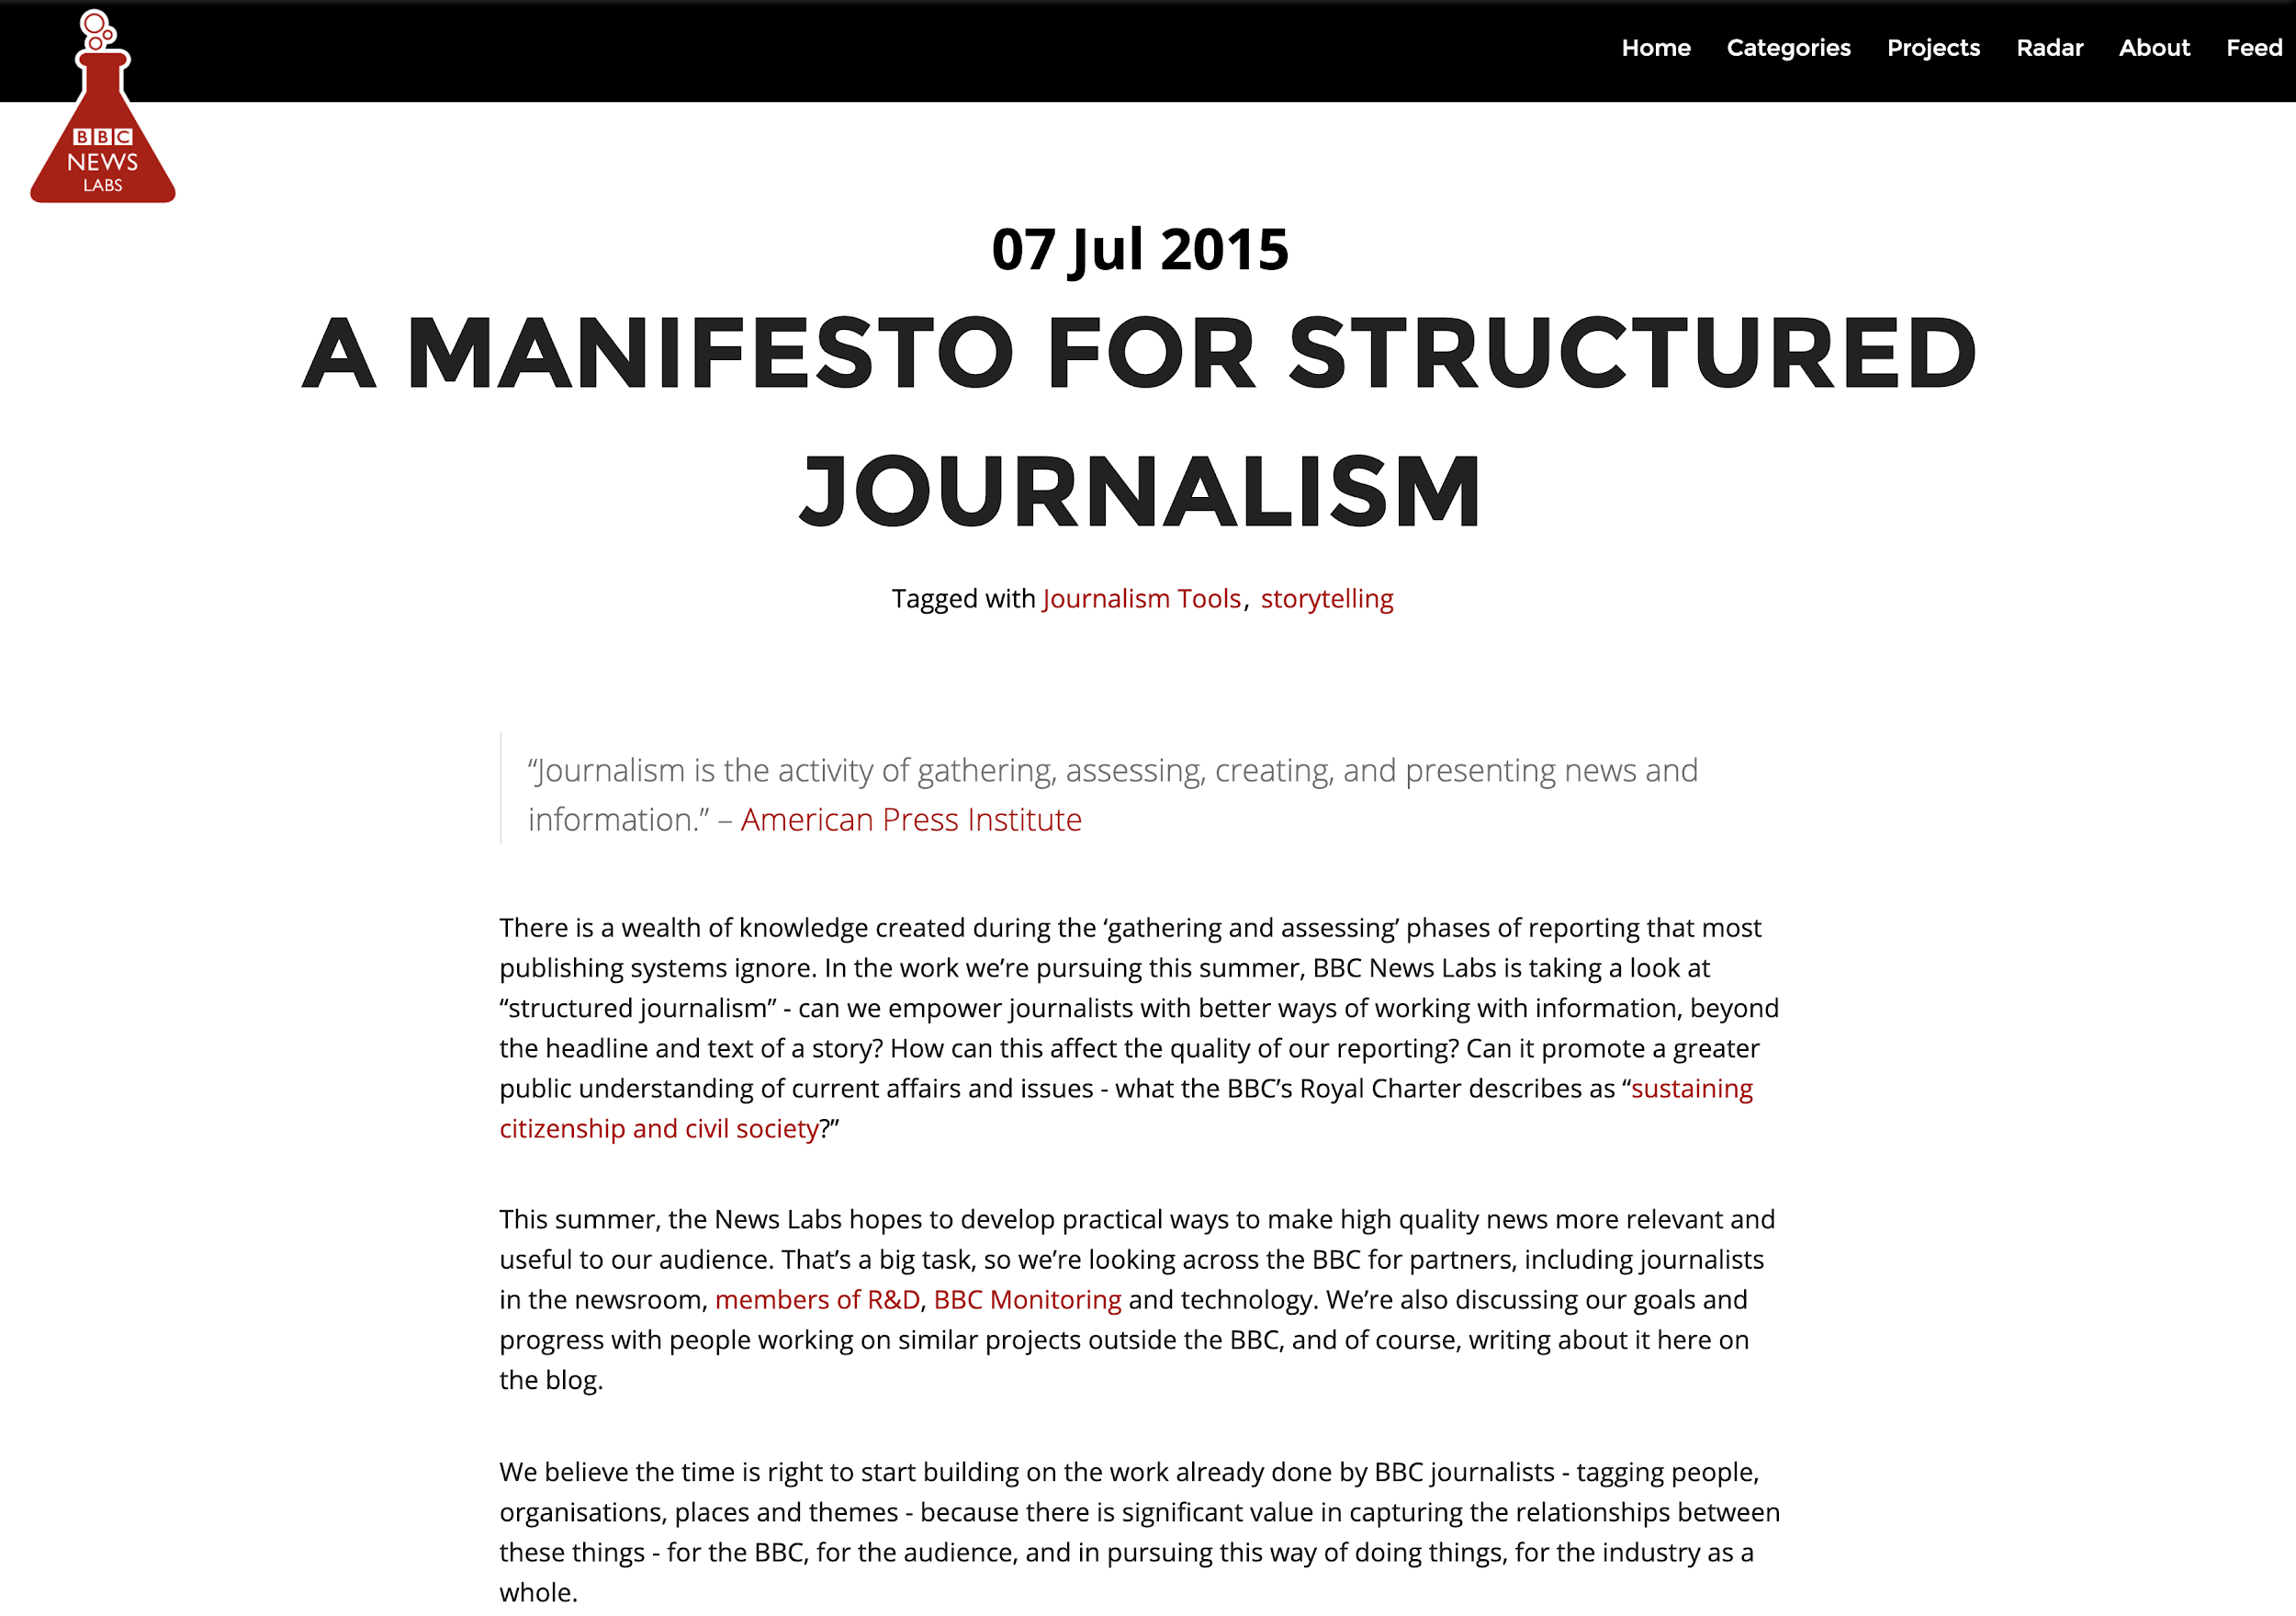
https://web.archive.org/web/20151218173643/http://bbcnewslabs.co.uk/2015/07/07/a-manifesto-for-structured-journalism/

Slide 33
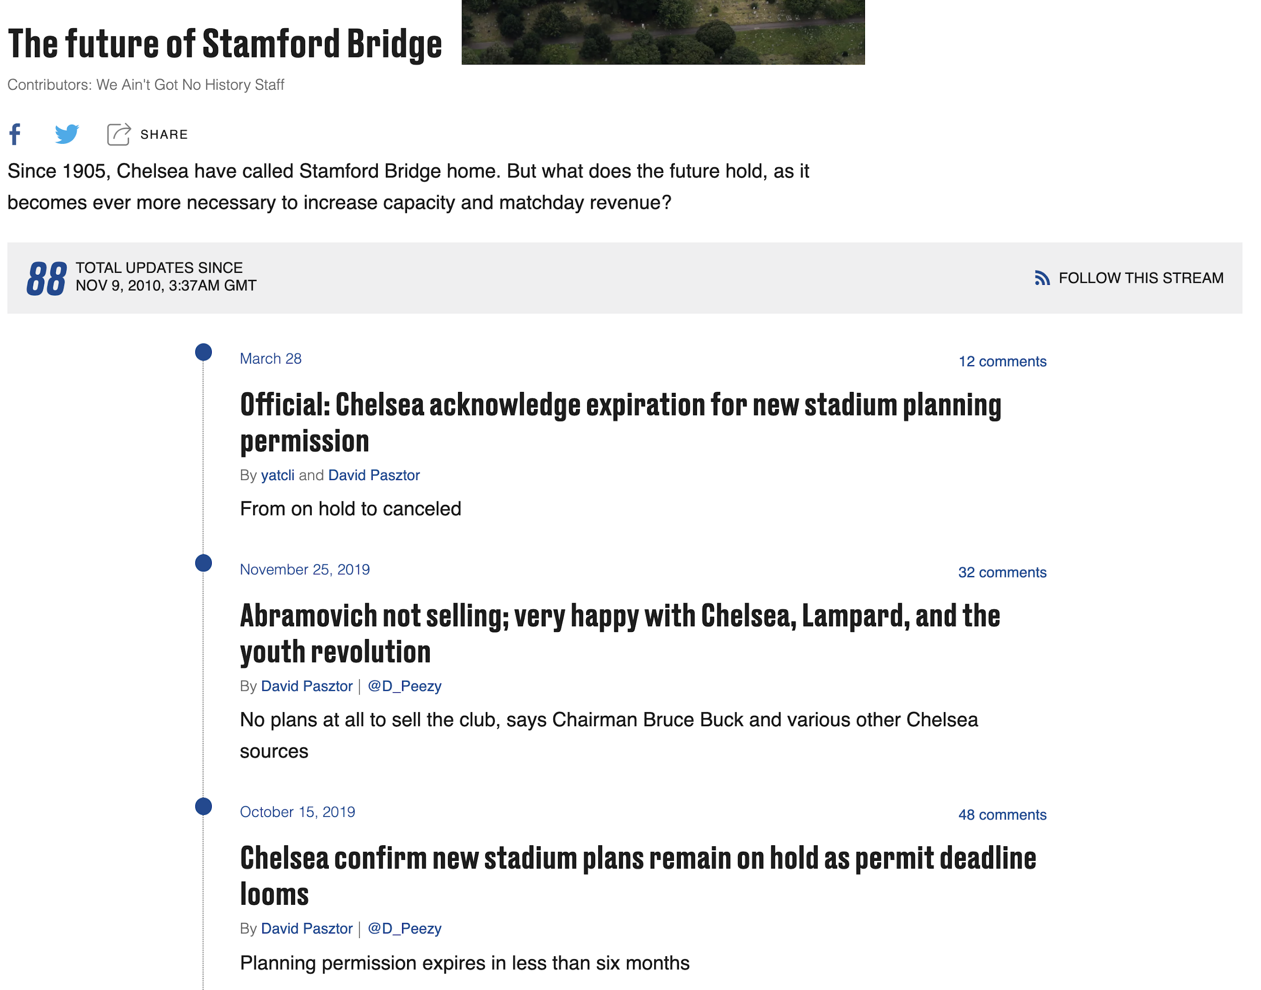
SBNation/
Vox Media’s Storystreams

Slide 34
Summing up

Slide 35
Key Points
The ‘world’ of a story can be the basis for much more than tag aggregations.
Link the ‘things’ together in a way that represents story relationships.
The order in which you reveal information is crucial to how audiences understand stories.
The time over which you tell a story can also shape audience behaviour and reactions.
Drama isn’t conflict - it’s the disparity of knowledge.
The asymmetry of knowledge between various parties can be harnessed (and exploited).
Surfacing different stories and interpretations of the same events is fertile ground for innovation.

Slide 36
Thank you!
Paul Rissen
Senior Product Manager, Springer Nature
@r4isstatic

