Slide 1

Knowledge Graphs, Part II: Practical Applications
Tuesday, 18 August 2020
Bob Kasenchak, Senior Manager, Client Solutions
Ahren E. Lehnert, Senior Manager, Text Analytics Solutions
synaptica
25 years of innovation
© 1995 – 2020, Synaptica®
 |  | Slide 1 of 8

Slide 2
synaptica
Webinar Objectives
25 years of innovation
In this webinar, we will cover
knowledge management, publishing, and advanced knowledge graph industry use cases
practical knowledge graph implementations

Slide 3


synaptica
The Presenters
25 years of innovation
Ahren E. Lehnert
Senior Manager, Text Analytics Solutions
Bob Kasenchak
Senior Manager, Client Solutions
Information and knowledge management professional with over fifteen years’ experience in taxonomy, text analytics, search, and content and records management. Ahren is Senior Manager, Text Analytics Solutions at Synaptica, LLC, a provider of taxonomy, ontology, and text analytics products and services.
Taxonomist and ontologist with a focus on vocabulary development, indexing, software, and text analytics. Developed vocabulary projects for publishers and other enterprise clients.
@ahrenlehnert
@taxobob
ahren.lehnert@synaptica.com
bob.kasenchak@synaptica.com
www.synaptica.com
www.synaptica.com

Slide 4
synaptica
About Synaptica
25 years of innovation
Synapse founded: a service bureau for building taxonomies
Acquired by
Dow Jones & Company
Launched Graphite
Linked Data KOS
& Text Analytics Platform
Launched
Taxonomy Warehouse
Auto Match, Indexing Management System, MyViews, Visualization Suite
End-to-end Synaptica Integrated
Solutions
1995
2000
2005
2010
2015
2020
Built a web-based taxonomy collaboration platform called Synaptica
Contributed to US National Standard ANSI/NISO Z39.19
Synaptica reincorporated as a private software company
Launched OASIS deep image semantic annotation system – built on graph database technology
Providing enterprise taxonomy software to our services clients

Slide 5

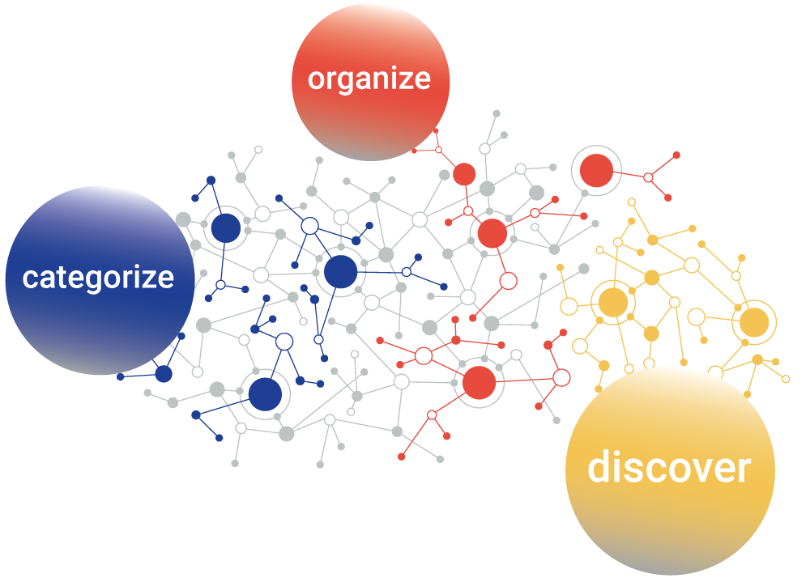
synaptica
About Synaptica
25 years of innovation
We help people to organize, categorize, and discover knowledge.

Slide 6

synaptica
About Synaptica
25 years of innovation
Taxonomies are Knowledge Organization Systems (KOS)
When we do taxonomy, we use industry standard data models to centralize and standardize the terminology used in our enterprise
We define and unambiguously label enterprise terminology, and then we organize it into hierarchical and associative concept schemes, which we call taxonomies or ontologies
These schemes help us to understand how concepts, people, places, products, processes, and organizations all relate to one another

Slide 7
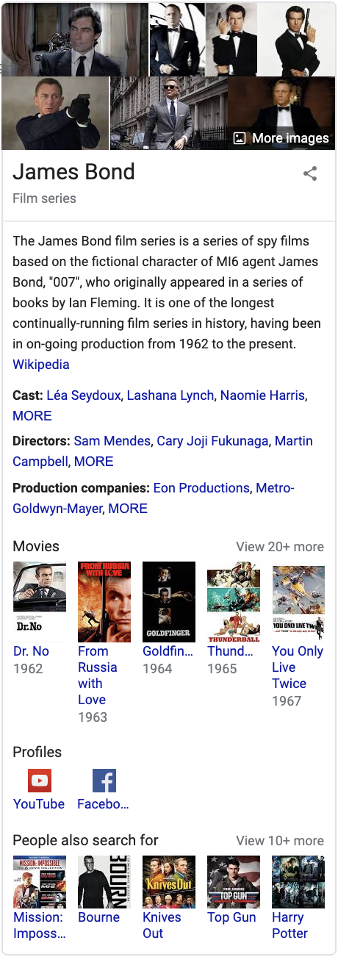
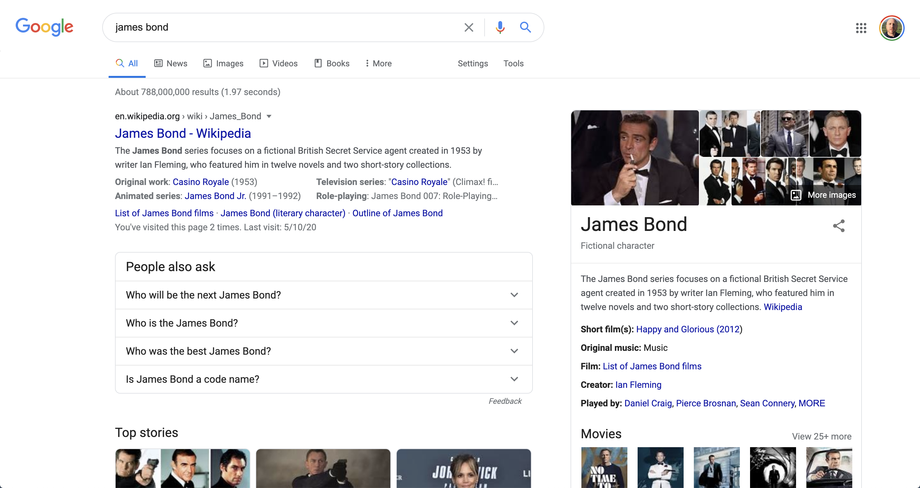
synaptica
Use Cases
Google Knowledge Graph
25 years of innovation
7 of 8

Slide 8
synaptica
Use Cases
Google Knowledge Graph
25 years of innovation
The Knowledge Graph is a knowledge base used by Google and its services to enhance its search engine's results with information gathered from a variety of sources.*
  Started in May 2012
  Sources
  Google Image Search
  Wikipedia & Wikidata
  Movies (IMDB?)
  Social Media Profiles
  Google Search
  Preferred Sources: Sponsored Ads, LyricFind, Google Books, etc.
*“Knowledge Graph.” Wikipedia, Wikimedia Foundation, Inc., 4 August 2019, https://en.wikipedia.org/wiki/Knowledge_Graph.
8 of 8

Slide 9
synaptica
25 years of innovation
Our Use Cases

Slide 10
synaptica
Use Case: Knowledge Management
25 years of innovation
A large entertainment software company
Ontology workflow governance process between content creators and ontologists
Tagging Confluence wiki pages using ontologies
Content authors able to suggest concepts in the same tagging interface
Linked Data definitions and other fields available on hover to content authors
Visualization tools used internally to model and "sell" ontologies to stakeholders

Slide 11
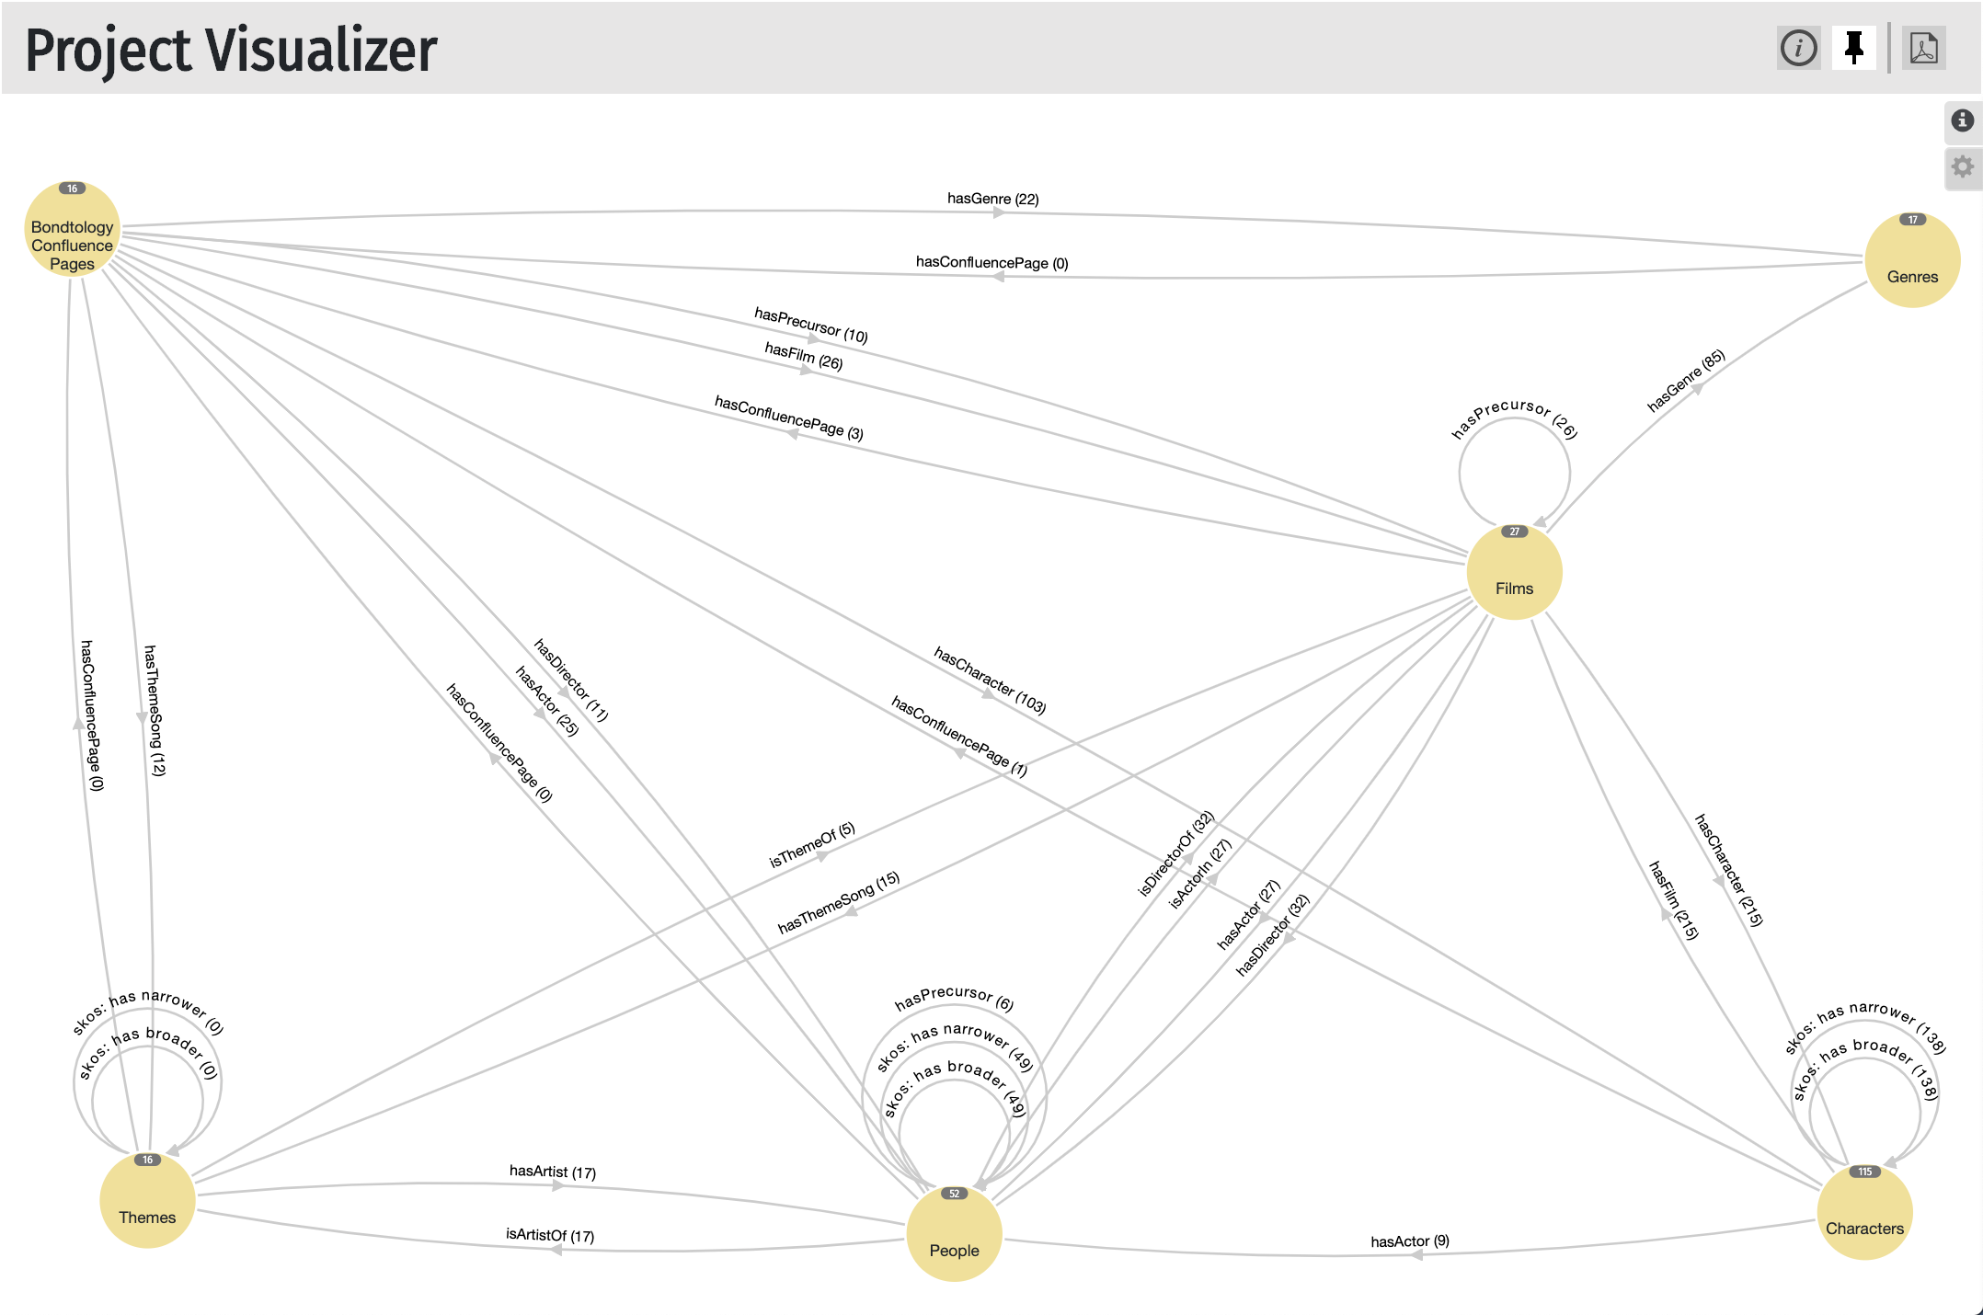
synaptica
Use Case: Knowledge Management
25 years of innovation

Slide 12
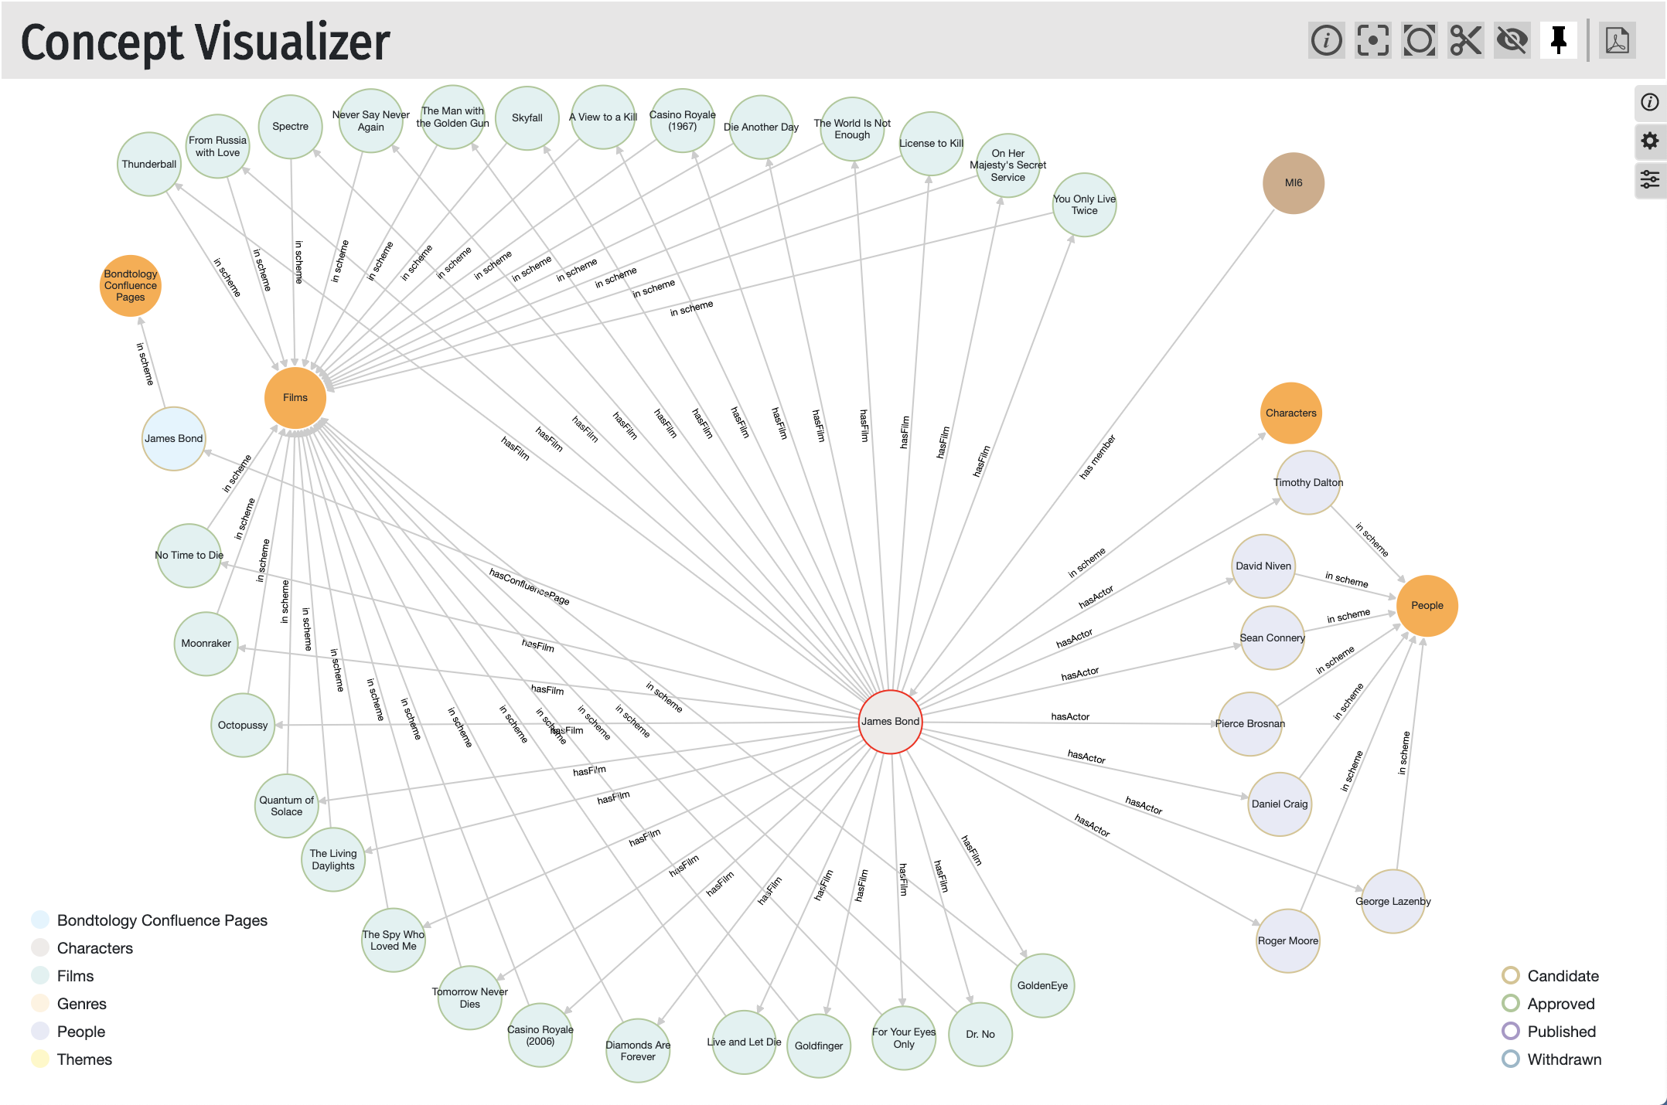
synaptica
Use Case: Knowledge Management
25 years of innovation

Slide 13
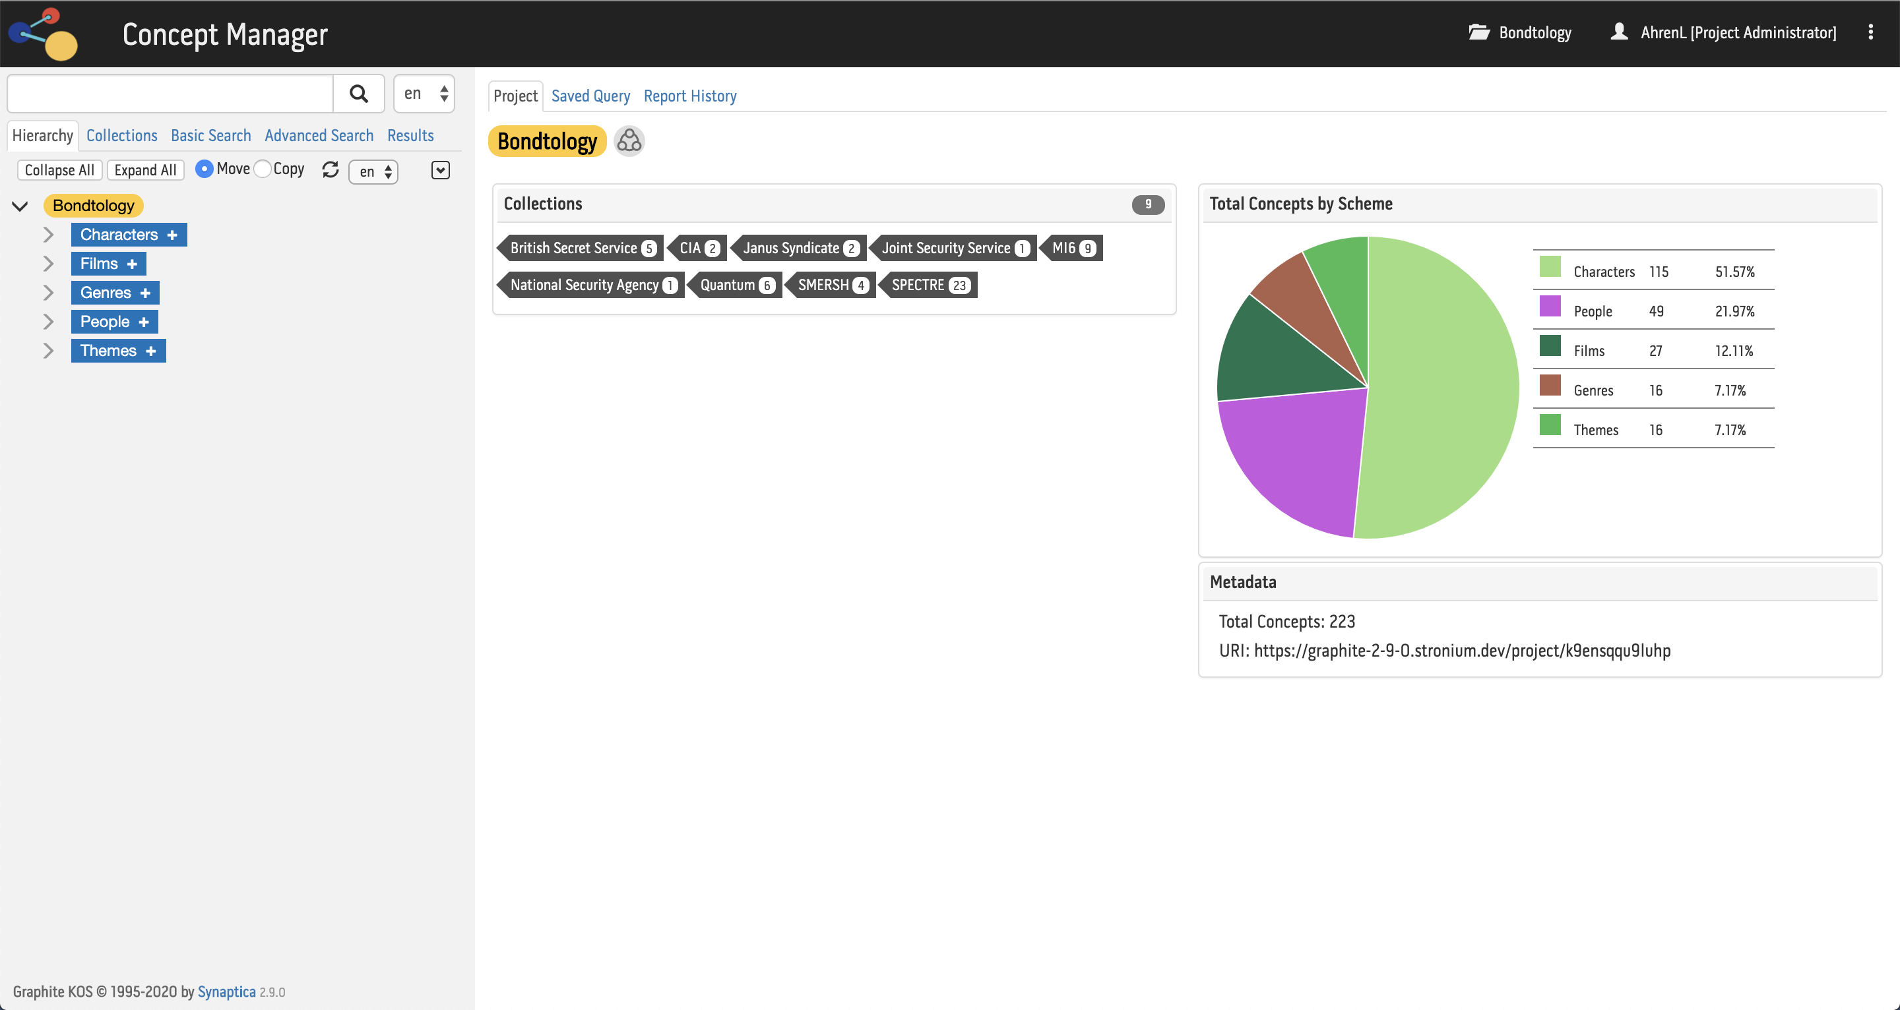
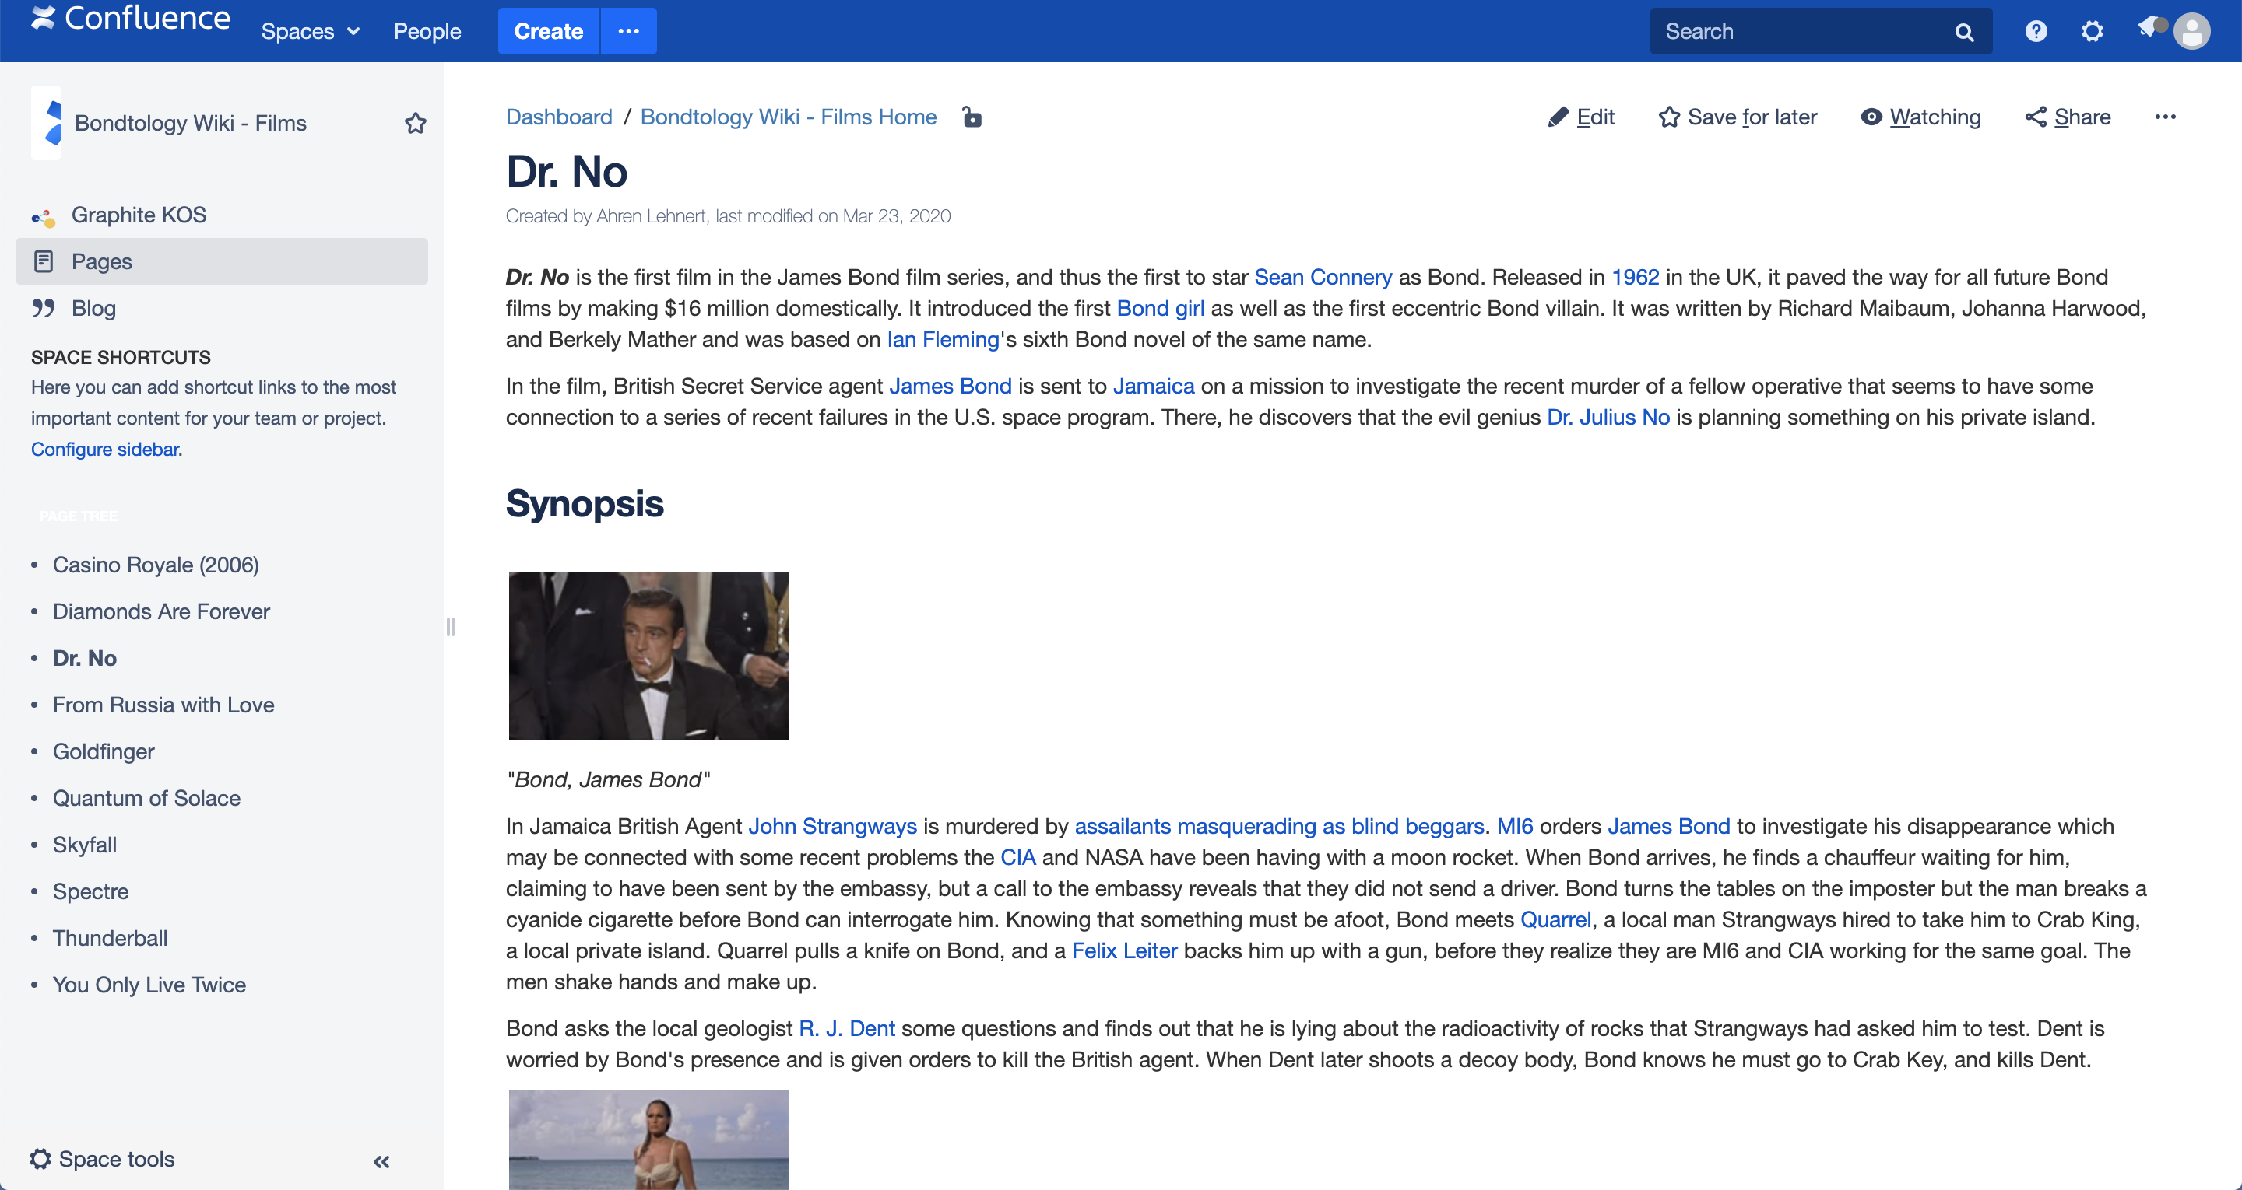
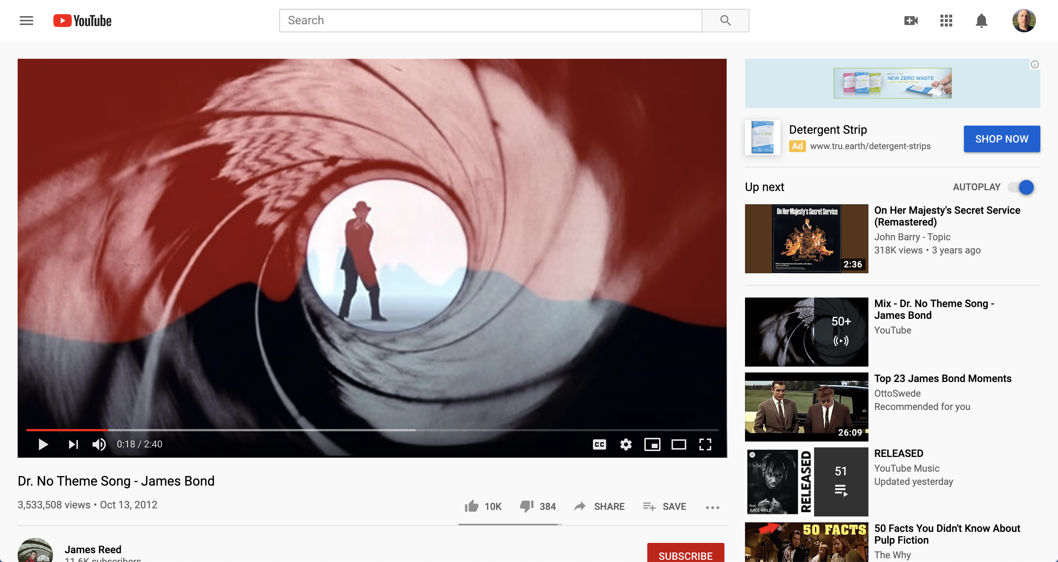
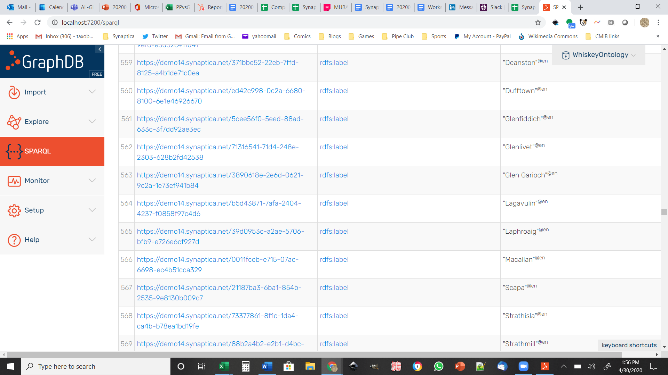
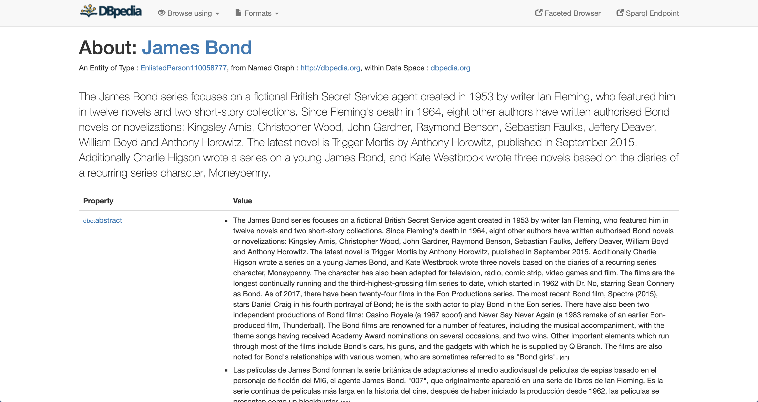
synaptica
Knowledge Graph Use Case
25 years of innovation
Ontology Management System
Confluence Wiki
YouTube
Graph Database
(Ontotext GraphDB)
DBpedia (Linked Data)

Slide 14

synaptica
A Sample Knowledge Graph
25 years of innovation
We built a knowledge graph by combining
Our James Bond ontology, the Bondtology
Linked Data from DBpedia
Atlassian Confluence as a content management system
GraphDB

Slide 15
synaptica
Use Case: Publishing
25 years of innovation
From Structured Data to Knowledge Graphs
Broad overview:
Extract structured data
Express relationships between objects
Ingest into a suitable application
Expose data through a UI

Slide 16
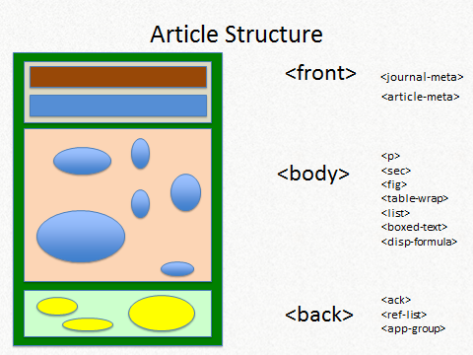
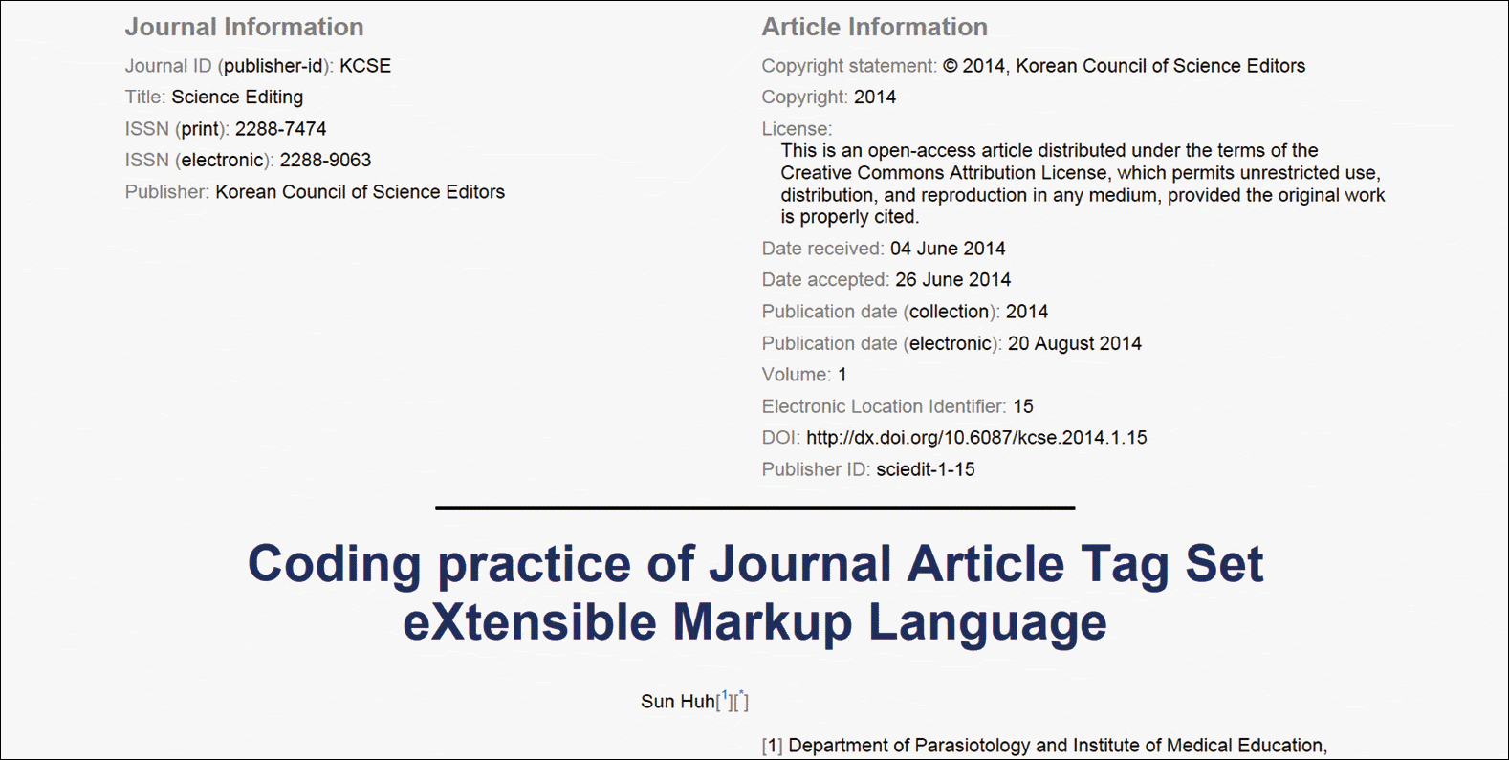
synaptica
Use Case: Publishing
25 years of innovation
From Structured Data to Knowledge Graph

Slide 17
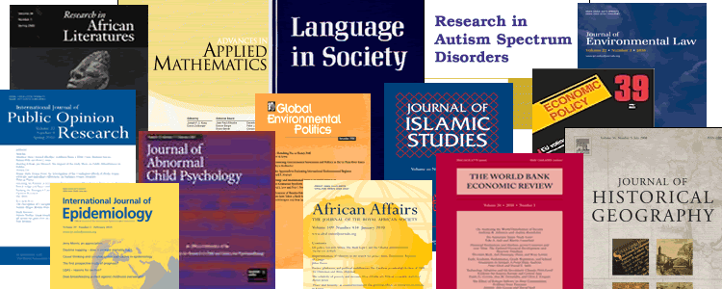
synaptica
Use Case: Publishing
25 years of innovation
From Structured Data to Knowledge Graph
900,000 Articles =/= a Database

Slide 18
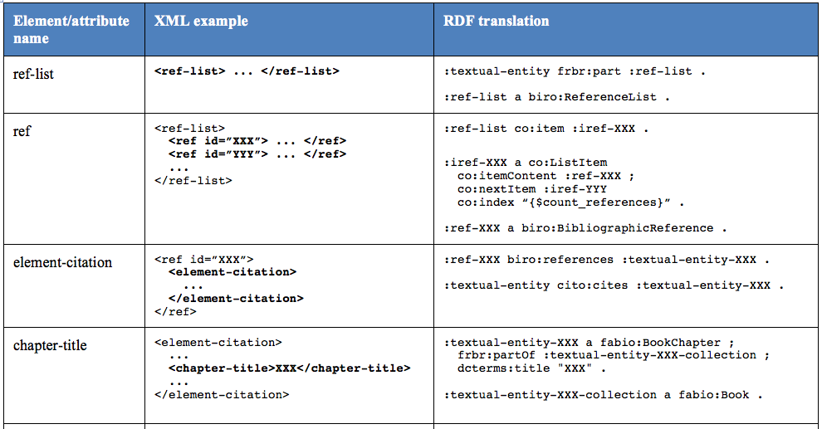
synaptica
Use Case: Publishing
25 years of innovation
JATS to RDF
https://opencitations.wordpress.com/2012/12/20/mapping-jats-to-rdf/

Slide 19
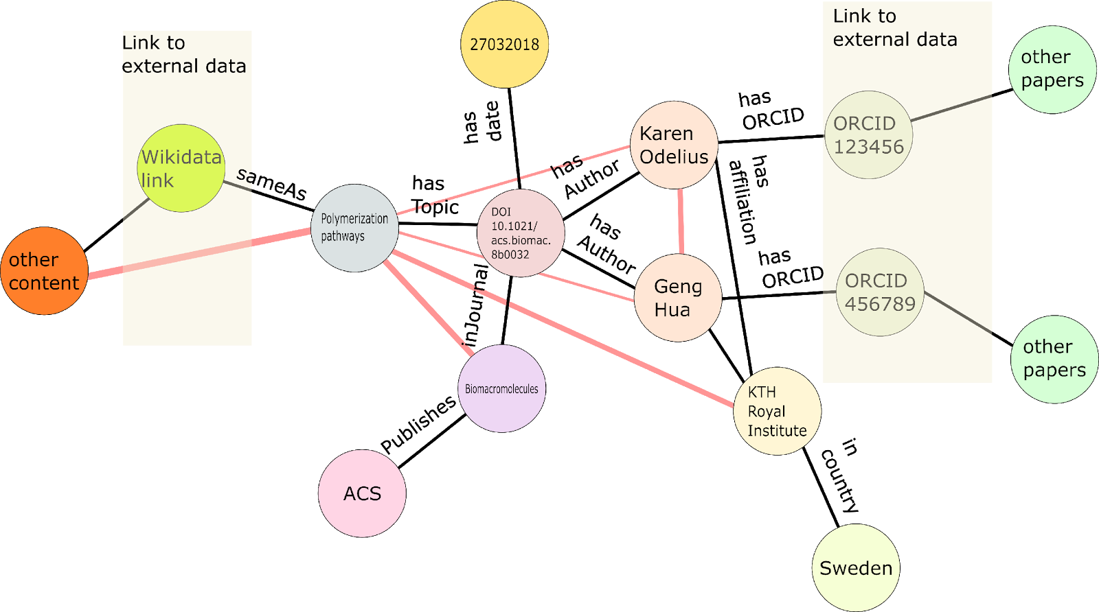
synaptica
Use Case: Publishing
25 years of innovation
Semantic Web/Linked Data

Slide 20
synaptica
25 years of innovation
Industry
Use Cases

Slide 21
synaptica
Use Case: Tax Knowledge Graph
25 years of innovation
Intuit's Tax Knowledge Graph
Represents the complexity of the United States Tax Code, including instructions, requirements, tax forms, and yearly changes
Presents in a user-friendly, interactive UI for end users doing their taxes
Yu, Jay. “Knowledge Graph Use Cases @ Intuit”. Stanford CS 520 Knowledge Graphs. 26 March 2020. Accessed 23 July 2020. https://www.youtube.com/watch?v=bvwjG-3qAmY&feature=youtu.be.

Slide 22
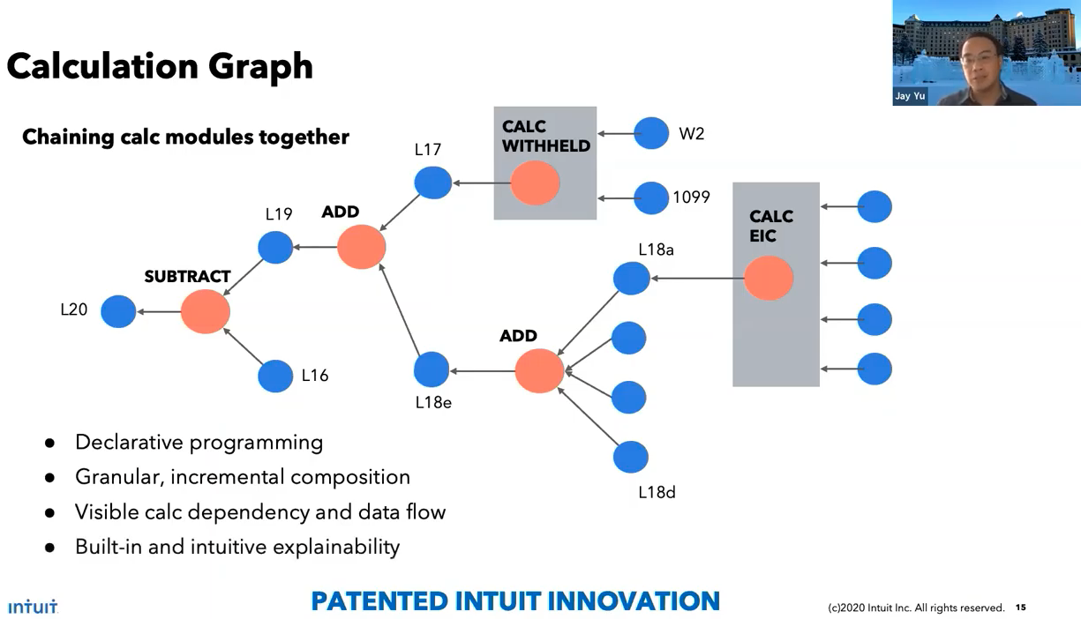
synaptica
Use Case: Tax Knowledge Graph
25 years of innovation
Yu, Jay. “Knowledge Graph Use Cases @ Intuit”. Stanford CS 520 Knowledge Graphs. 26 March 2020. Accessed 23 July 2020. https://www.youtube.com/watch?v=bvwjG-3qAmY&feature=youtu.be.

Slide 23
synaptica
Use Case: Financial
25 years of innovation
JP Morgan Chase & Co.
Traversing a graph for fraud detection
Knowledge graph is used internally, not for end users
Saxena, Apoorv. “Applications of Knowledge Graphs”. Stanford CS 520 Knowledge Graphs. 26 March 2020. Accessed 23 July 2020. https://www.youtube.com/watch?v=bvwjG-3qAmY&feature=youtu.be.

Slide 24
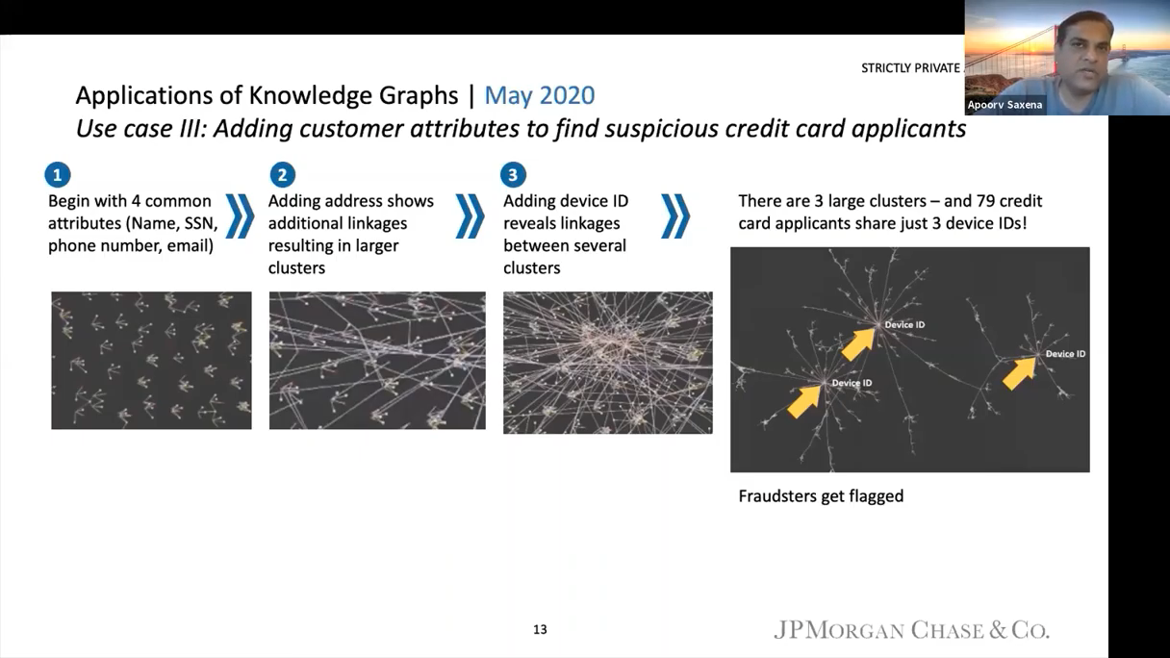
synaptica
Use Case: Financial
25 years of innovation

Slide 25
synaptica
Use Case: General Knowledge Graphs
25 years of innovation
Diffbot
General knowledge database reflecting human knowledge
Automatically synthesized knowledge graph from full public web
10+ billion entities and 1 trillion+ facts
Accessible via API, dashboard, and integrations
Tung, Mike. “What Are Some Advanced Knowledge Graphs?”. Stanford CS 520 Knowledge Graphs. 26 March 2020. Accessed 23 July 2020. https://www.youtube.com/watch?v=bvwjG-3qAmY&feature=youtu.be.

Slide 26
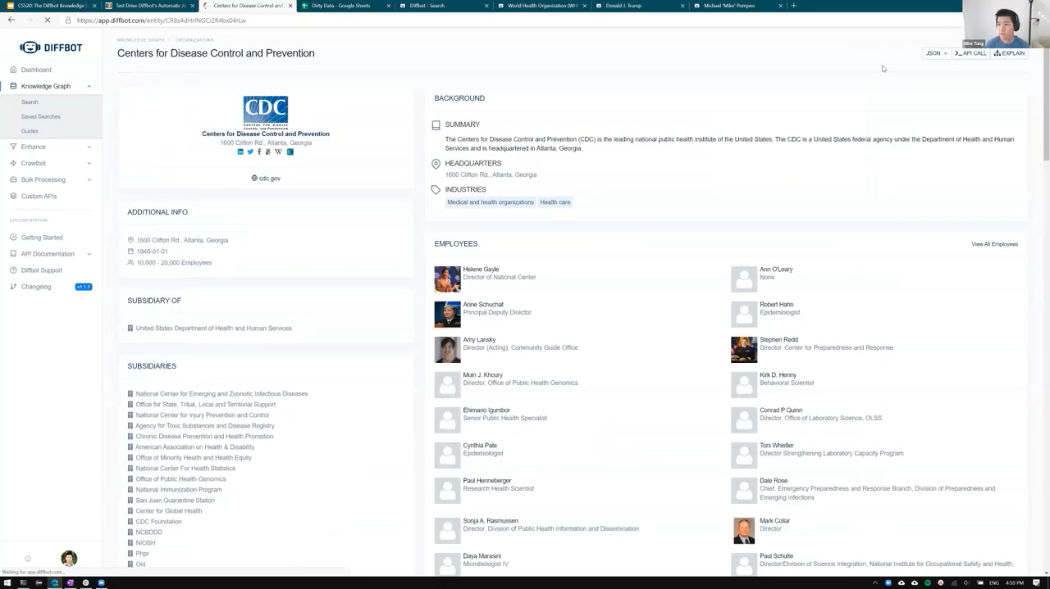
synaptica
Use Case: General Knowledge Graphs
25 years of innovation

Slide 27
synaptica
Summary
25 years of innovation
In summary,
Knowledge graphs are being used across industry sectors and business units
Use cases are diverse: content tagging, machine learning, analytics dashboards, integrating from multiple sources, etc...
Information management professionals can get started in knowledge graphs without computer science backgrounds

Slide 28
www.synaptica.com
info@synaptica.com
synaptica
25 years of innovation
© 1995 – 2020, Synaptica®

